Slide 1
What’s Ahead for Embedded Software? Author: Edward A. Lee @University of California, Berkeley
YIN XIAOPENG

Slide 2
outline
Introduction
Frameworks
H/W – S/W Partnership
Real-time Scheduling
Interfaces and Types
Metaframeworks

Slide 3
Introduction
Embedded software is ubiquitous
Why embedded software research now?
Design challenges
Interface to the real world
Research questions:
“how to reconcile a set of domain-specific requirements with the demands of interaction in the physical world”

Slide 4
Frameworks
What is the framework:
a set of constraints on components and their interaction
a set of benefits that derive from those constraints
defines a model of computation, which governs the interaction of components
Four service categories of most frameworks:
Ontology: defines what it means to be a component.
Epistemology: defines a states of knowledge.
Protocols: provides mechanisms that dictate how components interact.
Lexicon: defines the possible messages.

Slide 5
Frameworks
More constraints, more specific
This specificity comes with benefits
Unix pipes
Internet
Framework is deeply ingrained in the culture of designers who use it
turing sequentiality of computation
Key challenge
invent frameworks with properties that better match the application domain

Slide 6
Frameworks
Concurrency
A concurrent framework defines the “laws of physics,” fashioning the ontology, protocols, and epistemology to achieve a particular approach to concurrent computing.
No universal concurrent framework has yet merged.
Von Neumann framework
reduces time to a total order of discrete events, in which sequencing is sufficient for correctness
Events are partially ordered at best
Problem in networked embedded systems
A framework well suited to small latencies is usually poorly suited to large latencies—and vice versa

Slide 7
frameworks
Sample frameworks
Diversity makes it hard to select a framework
As the level of abstraction and domain-specificity rise
Time is one dimension in which these views differ
Real number
discrete
partially ordered
Mixing frameworks
A grand unified approach to modeling would seek a concurrent framework that serves all purposes
create the union of all the frameworks - resulting framework would be extremely complex and difficult to use
use an architecture description language (ADL) to define a framework – sometime ADL and design are poor match
heterogeneously mix frameworks, instead of forming the union of their services, preserve their distinct identity

Slide 8
H/W – S/W Partnership
Software
primarily sequential execution with a single instruction stream
the same hardware resources are multiplexed in time to perform a variety of functions
Hardware
primarily parallel execution
hardware resources are not shared
Embedded system
Involve both S/W and H/W
Explore the balance between sequential and parallel execution styles

Slide 9
Real – Time Scheduling
provides some assurances of timely performance given certain component properties
Rate-monotonic scheduling principles
translate the invocation period into priorities
Priorities are based on semantic information, reflecting the criticality
Most methods are not compositional
Priority inversion – a chronic issue in scheduling
Occurs when process interact by entering a monitor to exclusively access a shared resource
Priority-based scheduling scheme
processes interact both through the scheduler and through the mutual-exclusion mechanism (monitors) that the framework supports
no coherent compositional semantics

Slide 10
Interface and Types
Type systems
one of the great practical triumphs of contemporary software
provide a vocabulary for talking about larger structure than lines of code and subroutines
Ensure software’s correctness
Disadvantage: only talk about static structure
Type system techniques
Mathematically, depend on partial type ordering defined by subtyping relation or lossless convertibility
describe an interface’s dynamic properties using nondeterministic automata
Then define a pertinent partial ordering relation using the simulation relation among automata

Slide 11
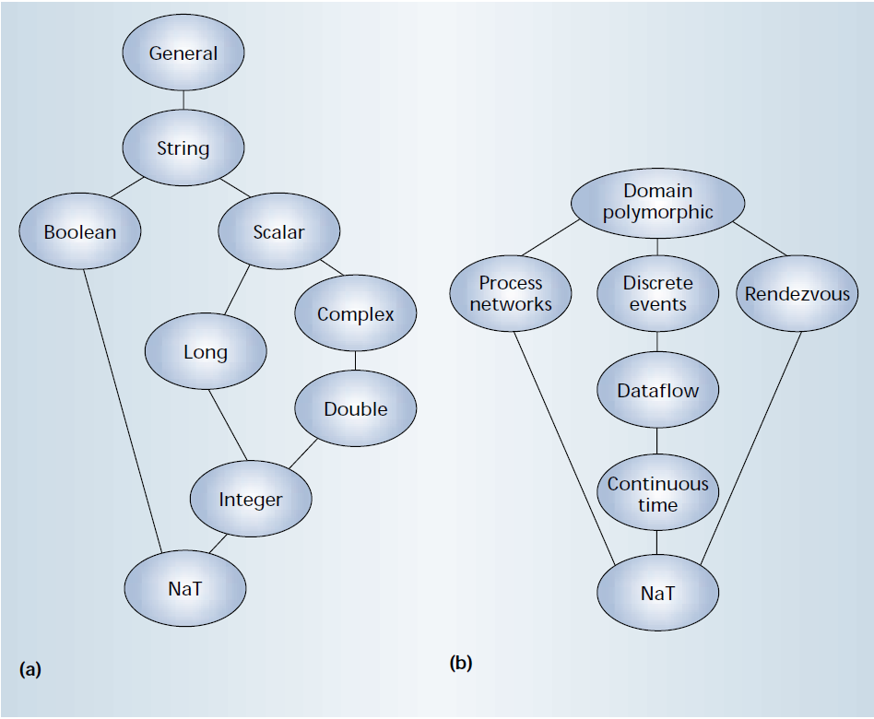
Interface and Types
How a type system works

Slide 12
Metaframework
All frameworks impose some constraints to achieve certain benefits
stronger benefits come at the expense of stronger constraints
Cannot solve all the framework problems for any complex system
Mix frameworks heterogeneously
avoid giving up the benefits of specialized frameworks
The ways to mix
through specialization where one framework is simply a more restricted version of another
mix frameworks hierarchically

Slide 13
Other research problems
Human-computer interaction
key to making embedded systems pervasive and useful
Networking problems
particularly provide quality-of-service guarantees in the face of unreliable resources
Power consumption problems
hardware and software design techniques that minimize power consumption for portable devices

