Slide 1
Scale and Performance in a Distributed File System
John H. Howord et. al.
in ACM Transactions on Computer Systems Vol. 6, No. 1, 1988
Presented by Jiwoo Bang, Moonsub Kim

Slide 2
Presentation Outline
Andrew File System Prototype
Overview of Andrew File System (AFS)
Performance Evaluation Of AFS Prototype
Changes For Performance
Revised Andrew File System
Effect of Changes For Performance
Performance Comparison of NFS and AFS
Changes for Operability
Conclusion

Slide 3
Part 1. Andrew File System Prototype

Slide 4
Andrew File System
Distributed File System developed in CMU
A distributed implementation of a file system, where multiple users share files and storage resources
Overall storage space managed by a DFS is composed of different, remotely located, smaller storage spaces
Presents a homogeneous, location-transparent file name space
AFS architecture is based on observations …
Shared files are infrequently updated
Files are normally accessed by only a single user
Local caches are likely to remain valid for long periods

Slide 5
Andrew File System
Caching in Distributed File System
Retaining most recently accessed disk blocks
Repeated accesses to a block in cache can be handled without involving the disk
Reduce network traffic and server contention
Scalability is most important design goal of AFS
Unusual Design Features
Whole-file caching

Slide 6
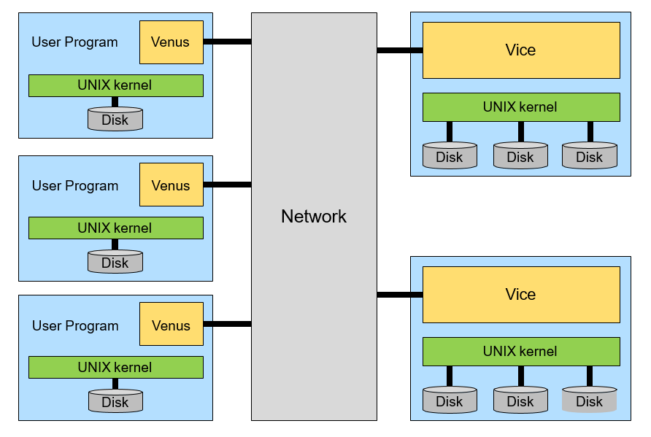
Andrew File System Architecture

Slide 7
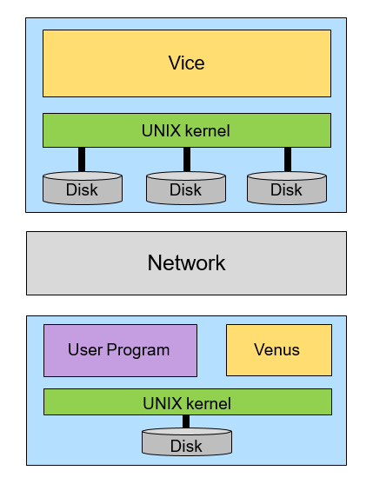
Andrew File System Prototype
Vice (Server)
Serve files to Venus
A set of trusted servers, collectively called Vice
A process running on server side
Vice process dedicated to each Venus client
Venus (Client)
Cache files from Vice
Contacts Vice only when a file is opened or closed
Reading and writing are performed directly on the cached copy (client side)

Slide 8
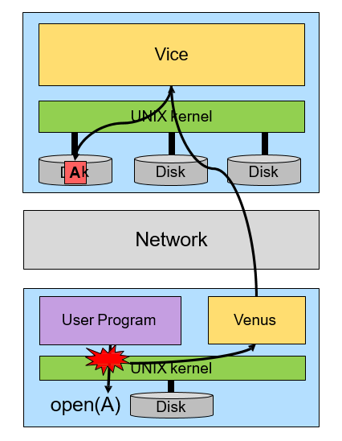
Andrew File System Prototype
Vice (Server)
Serve files to Venus
A set of trusted servers, collectively called Vice
A process running on server side
Vice process dedicated to each Venus client
Venus (Client)
Cache files from Vice
Contacts Vice only when a file is opened or closed
Reading and writing are performed directly on the cached copy (client side)

Slide 9
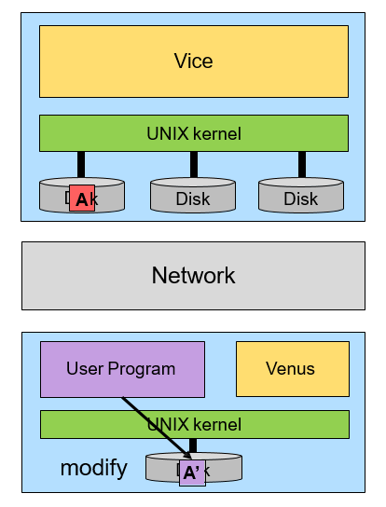
Andrew File System Prototype
Vice (Server)
Serve files to Venus
A set of trusted servers, collectively called Vice
A process running on server side
Vice process dedicated to each Venus client
Venus (Client)
Cache files from Vice
Contacts Vice only when a file is opened or closed
Reading and writing are performed directly on the cached copy (client side)

Slide 10
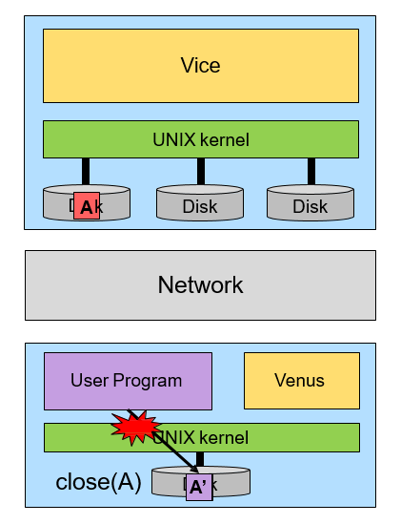
Andrew File System Prototype
Vice (Server)
Serve files to Venus
A set of trusted servers, collectively called Vice
A process running on server side
Vice process dedicated to each Venus client
Venus (Client)
Cache files from Vice
Contacts Vice only when a file is opened or closed
Reading and writing are performed directly on the cached copy (client side)

Slide 11
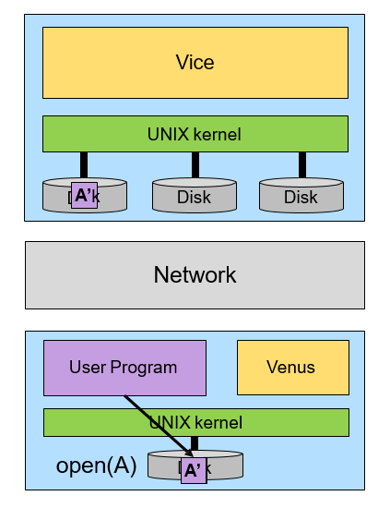
Andrew File System Prototype
Vice (Server)
Serve files to Venus
A set of trusted servers, collectively called Vice
A process running on server side
Vice process dedicated to each Venus client
Venus (Client)
Cache files from Vice
Contacts Vice only when a file is opened or closed
Reading and writing are performed directly on the cached copy (client side)

Slide 12
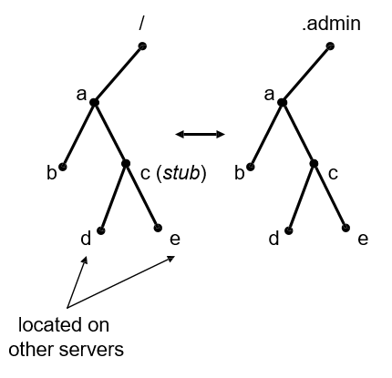
Andrew File System Prototype
Vice maintains status information in separate files
.admin directory to store configuration data
directory hierarchy mirroring original vice file structures
Stub directory gives a name space located on other servers
If file not on a server, the search for its name would end in a stub directory

Slide 13
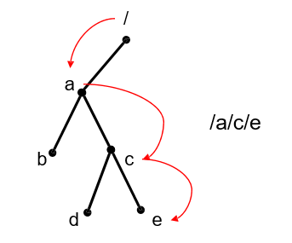
Andrew File System Prototype
Vice-Venus interface names files by their full pathname
there is no notion of low level file name such as inode
full path directory working is required

Slide 14
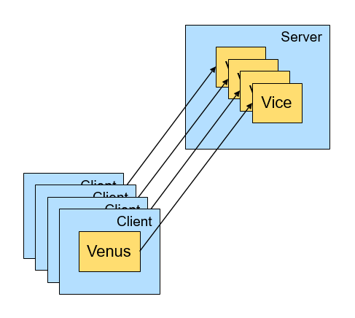
Andrew File System Prototype
Vice create dedicated processes for each client
the dedicated process persists until its client terminated
too frequent context switching

Slide 15
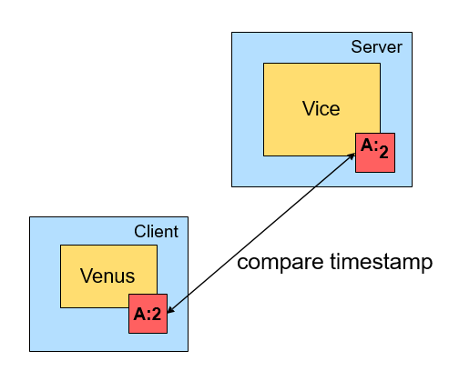
Andrew File System Prototype
Venus verify timestamps on every open
Each open include at least one interaction with a server
even if the file were already in the cache and up-to-date!

Slide 16
AFS Prototype Benchmark Setup
Load Unit
Load placed on a server by a single client
A Load Unit = about five Andrew users
Read-only source subtree
70 files
Total 200kbytes
Synthetic Benchmark
Simulate real user actions
MakeDir, Copy, ScanDir, ReadAll, Make

Slide 17
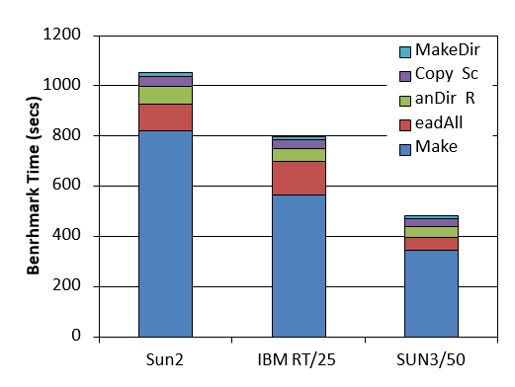
Stand-alone Benchmark Performance
MakeDir: Constructs a target subtree that is identical in structure to the source subtree
Copy: Copies every file from the source subtree to the target subtree
ScanDir: Recursively traverses the target subtree and examines the status of every file in it
ReadAll: Scans every byte of every file in the target subtree once
Make: Compiles and links all the files in the target subtree

Slide 18
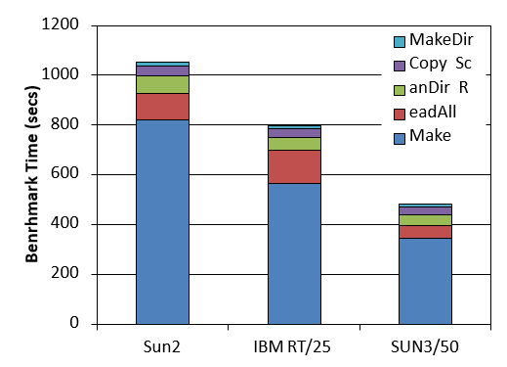
Stand-alone Benchmark Performance
Hit Ratio of Two Caches
81% for file cache
82% for status cache

Slide 19
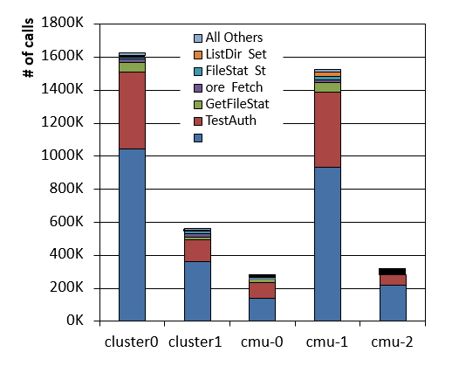
Distribution of Vice Calls in Prototype
TestAuth and GetFileStat are accounting for nearly 90% of the total calls!
Caused by frequency of cache validity check

Slide 20
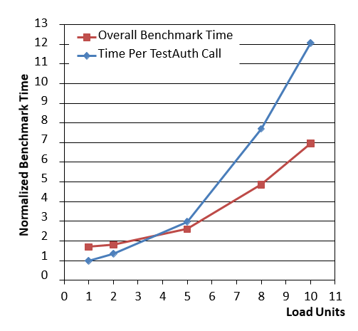
Prototype Benchmark Performance
Took about 70% longer at a load of 1 than in the stand-alone case
TestAuth rose rapidly beyond a load of 5
Running only between 5 and 10 servers is the maximum feasible

Slide 21
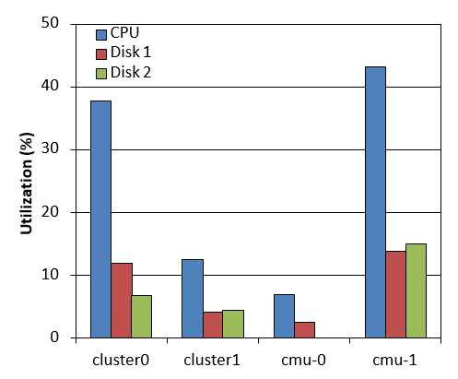
Prototype Server Usage
CPU utilization is too high!
Sever CPU is the performance bottleneck
Caused by frequent context switching
Traversing full pathnames
Server loads were not evenly balanced
Require load balancing between servers

Slide 22
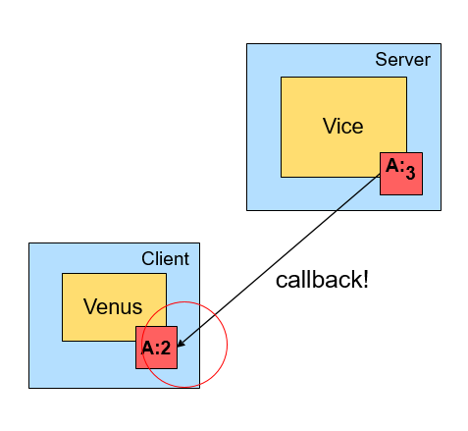
Changes For Performance
Cache Management
Caches the contents of directories and symbolic links in addition to files
Require workstations to do path name traversals
Callback
Venus assumes that cache entries are valid unless otherwise notified
Server promises to notify it before allowing a modification by any other workstation
Result
Dramatically reduces the number of cache validation requests received by servers

Slide 23
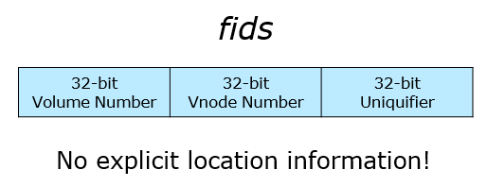
Changes For Performance
Name Resolution
Implicit namei in Venus was costly
Introduce fids (96-bits long)
32-bit Volume Number
Collection of files located on one server
32-bit Vnode Number
Used as an index into an array containing the file storage information for the files in a sing volume
32-bit Uniquifier
Allows reuse of vnode numbers

Slide 24
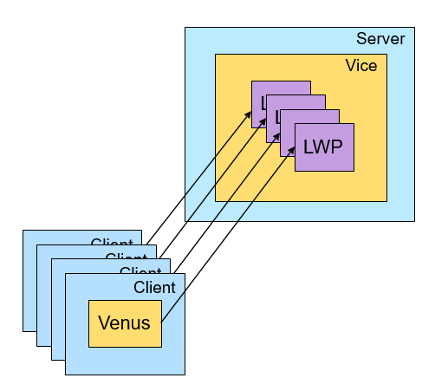
Changes For Performance
Communication and Server Process Structure
A single process to service all clients of a server
Using multiple Lightweight Processes (LWPs) within one process
Context switching is cheap

Slide 25
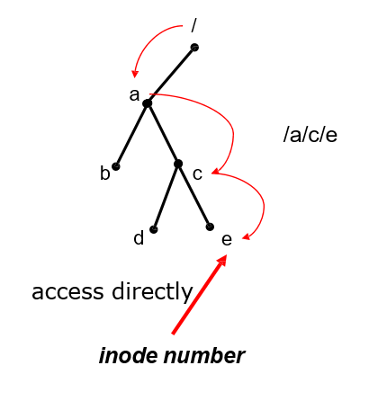
Changes For Performance
Low-Level Storage Representation
Access files by their inodes rather than by path names
Eliminated nearly all pathname lookups on workstations and servers

Slide 26
Part 2. Revised Andrew File System

Slide 27
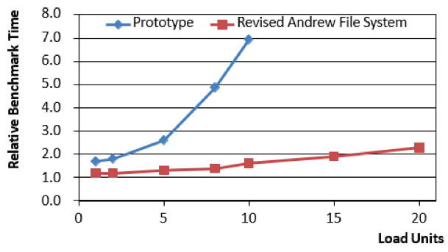
Revised AFS Benchmark Result
The design changes have improves scalability considerably
Comparison of prototype(basic FS architecture) and Revised AFS
Notes:
Scalability
Andrew is only 19% slower than a stand-alone workstation at load 1 (prototype was 70% slower)
Less than twice as long at a load of 15 as at a load of 1
The design changes have improved scalability considerably!

Slide 28
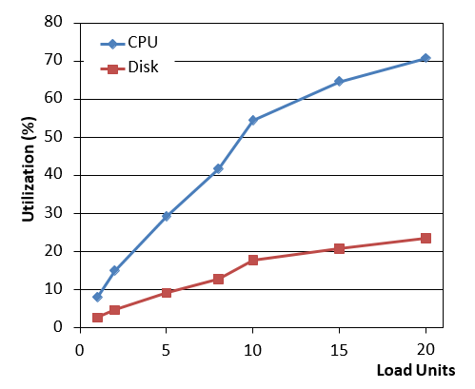
AFS Server utilization during the benchmark
For better performance, AFS server needs more efficient software or faster CPU
Notes:
CPU Utilization
Rises from % at a load of 1 to over 70% at a lo8ad of 20
At a load of 20 the system is still not saturated
But performance bound is still CPU
Disk Utilization
Below 20% even at a load of 20
Better performance requires,
More efficient server software
Faster server CPU

Slide 29
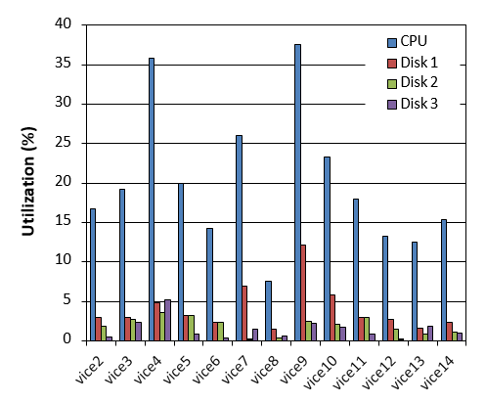
Andrew Server Usage
Most of servers show CPU utilizations between 15% and 25%
Notes:
Vice4
Caused by system maintenance activities that were performed during the unexpectedly period
Vice9
This server stores the bulletin boards which are accessed and modified by many different users
/*****************
GetTime
Most frequently called
Used by workstations to synchronize their clocks and as an implicit keepalive
FetchStatus
Generated by users listing directories
RemoveCB
Flushes a cache entry
Vice9: Indicates that the files it stores exhibit poor locality (mostly just one read for bulletin board)
Vice8: used by operation staff
Modification made to do RemoveCB on groups
*****************/

Slide 30
Comparison with A Remote-Open File System
Caching of entire file in the local disks of AFS was motivated by
Whole-file transfer contacts servers only on opens and closes, read-writes cause no network traffic
Whole-file transfer uses efficient bulk data transfer protocols.
The amount of data fetched after a reboot is usually small.
Caching of entire files simplifies cache management(no individual pages)
Notes:
그림넣을것!!!!

Slide 31
Comparison with A Remote-Open File System
Drawbacks of the entire file caching approach in AFS
Files that are larger than the local disk cache cannot be accessed at all
Strict emulation of 4.2BSD concurrent read and write semantics across workstations is impossible
But the Andrew File System does scale well.

Slide 32
Comparison with A Remote-Open File System
Distributed File Systems: Sun Microsystem NFS, AT&T RFS, Locus
The data in a file are not fetched at all
Instead, the remote site potentially participates in each individual read and write operation
Even though buffering and read-ahead are used to improve performance but the remote site is still conceptually involved in every I/O

Slide 33
Sun Network File System
Page caching: NFS caches inodes and individual pages of a file in memory.
Once a file is open, the remote site is treated like a local disk with read-ahead and write-behind of pages
Consistency semantics of NFS
A new file may not be visible elsewhere for 30 seconds
Two processes writing to the same file could produce a different results

Slide 34
Performance
NFS’s performance degrades rapidly with increasing load

Slide 35
Performance
Andrew well scales especially on ScanDir and ReadAll than NFS

Slide 36
CPU/Disk Utilization
Notes:
CPU utilization of NFS is much higher than AFS
At a load of 1, CPU utilization is about 22% in NFS but 3% in Andrew
At a load 18, CPU utilizations saturates at 100% in NFS but for Andrew 38% in the cold cache and 42% in the warm case
NFS used both disks on the server, with utilizations rising from about 9% and 3% at a load of 1 to nearly 95% and 19% at a load of 18 respectively
Disk 1: System libs.
Disk 2: User data
Andrew used only one of the server disks, with utilization rising from about 4% at a load of 1 to about 33% at a load of 18 in the cold cache case

Slide 37
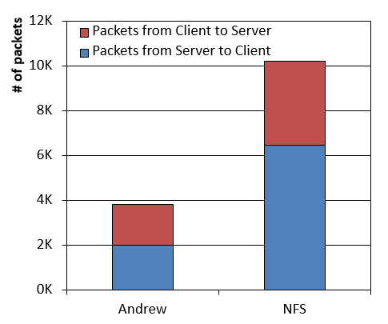
Network Traffic
NFS generates nearly three times as many packets as Andrew at a load of one

Slide 38
Changes for Operability
Goal: to build a system that would be easy for a small operational staff to run and monitor with minimal inconvenience to users
Problems in the prototype: inflexible mapping of Vice files to server disk storage
Vice was constructed out of collections of files glued together by the 4.2BSD Mount mechanism
Movement of files across servers was difficult (embedded file location info)
It was not possible to implement a quota system
The mechanisms of file location and file replication were cumbersome (consistency problem)
Standard backup utilities were not convenient for use in distributed environment
Backup needs the entire disk partition taken off-line

Slide 39
Changes for Operability
Volume
Collection of files forming a partial subtree of the Vice name space
Volumes are glued together at Mount Points
A volume resides within a single disk partition on a server
Volumes provides a level of Operational Transparancy
Volume Movement
Volume movement is done by creating a frozen copy-on-write snapshot of the volume
The volume move operation is atomic
Quotas
Quotas are implemented on a per volume basis

Slide 40
Changes for Operability
Read-Only Replication
Improves availability and balances load
No callback needed
The volume location database specifies the server containing the read-write copy of a volume and a list of read-only replication sites
Backup
Volumes form the basis of the backup and restoration mechanism
Create a frozen snapshot of a read-only clone, then transfer it

Slide 41
Conclusions
Design changes in the Prototype Andrew File System improved scalability considerably
At a load of 20, the system was still not saturated
A server using revised Andrew File System can serve more than 50 users
Changes in cache management, name resolution, server process structure, low-level storage representation
Volumes provide a level of Operational Transparency that is not supported by any other file system
Quota
Read-only replication
Simple and efficient backup

