Slide 1
A Survey of Peer-to-Peer Content Distribution Technologies
Authors:
STEPHANOS ANDROUTSELLIS-THEOTOKIS AND DIOMIDIS SPINELLIS
Athens University of Economics and Business
4190.662A Distributed Information Processing 2017 Fall
Presented by:
Simeon Varbanov
Hagos Alema
2017.11.7

Slide 2
Content
INTRODUCTION
Defining Peer-to-Peer Computing
Peer-to-Peer and Grid Computing
Classification of Peer-to-Peer Applications
Peer-to-Peer Content Distribution
ANALYSIS FRAMEWORK
PEER-TO-PEER DISTRIBUTED OBJECT LOCATION AND ROUTING
Centralization
Structure
Unstructured Architectures
Structured Architectures

Slide 3
Content
CONTENT CACHING, REPLICATION AND MIGRATION
SECURITY
Secure Storage
Secure Routing
Access Control, Authentication and Identity Management
PROVISIONS FOR ANONYMITY
PROVISIONS FOR DENIABILITY
INCENTIVE MECHANISMS AND ACCOUNTABILITY
Reputation Mechanisms
Micropayments Mechanisms
Resource Trading Schemes
RESOURCE MANAGEMENT CAPABILITIES
SEMANTIC GROUPING OF INFORMATION
CONCLUSIONS

Slide 4
Defining Peer-to-Peer Computing
Strictest definition of peer-to-peer
All nodes are completely equivalent in terms of functionality and tasks they perform.
These definitions fail to encompass systems that employ the notion of “supernodes”, which are widely accepted as peer-to-peer
Definition in Shirky[2000]
“peer-to-peer is a class of applications that take advantage of resources—storage, cycles, content, human presence—available at the edges of the internet”
This definition encompass systems that completely rely upon centralized servers for their operation
Overall no general suggestion what “is” Peer-to-Peer and what “is not”.
Author’s definition:
Peer-to-peer systems are distributed systems consisting of interconnected nodes able to self-organize into network topologies with the purpose of sharing resources such as content, CPU cycles, storage and bandwidth, capable of adapting to failures and accommodating transient populations of nodes while maintaining acceptable connectivity and performance, without requiring the intermediation or support of a global centralized server or authority.
Notes:
Due to the fact that systems or applications are labeled “peer-to-peer” not because of their internal operation or architecture, but rather as a result of how they are perceived “externally”, that is, whether they give the impression of providing direct interaction between computers. As a result, different definitions of “peer-to-peer” are applied to accommodate the various different cases of such systems or applications.

Slide 5
Peer-to-Peer and Grid Computing
What are grids?
Differences ?
To sum um:
In addition….
Grid computing addresses infrastructure, but not yet failure, while peer-to-peer addresses failure, but not yet infrastructure” [Foster and Iamnitchi 2003].
Notes:
Peer-to-peer and Grid computing are two approaches to distributed computing, both concerned with the organization of resource sharing in large-scale computational societies.
Grids are distributed systems that enable the large-scale coordinated use and sharing of geographically distributed resources, based on persistent, standards based service infrastructures, often with a high-performance orientation [Foster et al. 2001].
As Grid systems increase in scale, they begin to require solutions to issues of self configuration, fault tolerance, and scalability, for which peer-to-peer research has much to offer. Peer-to-peer systems, on the other hand, focus on dealing with instability, transient populations, fault tolerance, and self adaptation. To date, however, peer-to-peer developers have worked mainly on vertically integrated applications, rather than seeking to define common protocols and standardized infrastructures for interoperability
As peer-to-peer technologies move into more sophisticated and complex applications, such as structured content distribution, desktop collaboration, and network computation, it is expected that there will be a strong convergence between peer-to-peer and Grid computing [Foster 2000]. The result will be a new class of technologies combining elements of both peer-to-peer and Grid computing, which will address scalability, self adaptation, and failure recovery, while, at the same time, providing a persistent and standardized infrastructure for interoperability

Slide 6
Classification of Peer-to-Peer Applications
Communication and collaboration
Provide the infrastructure for facilitating direct, usually real time communication between peer computers. For example chat and instant messaging applications.
Distributed computation
Aim is to take advantage of the available peer computer processing power.
Achieved by breaking up and distributing the tasks and collecting the results.
Internet Service Support
Multicast systems, security applications
Database Systems
Local relation model : all data stored in inconsistent local relational databases.
Content distribution –most of the current P2P
Include systems and infrastructures designed for the sharing of data between users
Relatively simple to more sophisticated systems
Napster, Gnutella, Freenet, Chord, Scan, PAST
This survey focus on content distribution!!!

Slide 7
Peer-to-Peer Content Distribution
Classification of P2P content distribution applications
P2P “file exchange” systems
Simple, one-off file exchanges between peers.
Light-weight without addressing security, availability, persistence.
P2P content publishing and storage systems
Distributed storage medium : users able to publish, store, and distribute content with security, persistency.
Security and persistency are main focus.
Notes:
In its most basic form, a peer-to-peer content distribution system creates a distributed storage medium that allows for the publishing, searching, and retrieval of files by members of its network. As systems become more sophisticated, nonfunctional features may be provided, including provisions for security, anonymity, fairness, increased scalability and performance, as well as resource management and organization capabilities

Slide 8
Peer-to-Peer Content Distribution
Classification of P2P infrastructures
Routing and location
Route with efficiency and fault tolerance, efficiently locating peers and content
Anonymity
Provide user anonymity
Reputation management
Reputation update with various network nodes. Need reputation management infrastructures
Notes:
This category includes peer-to-peer based infrastructures that do not constitute working applications, but provide peer-to-peer based services and application frameworks. The following infrastructure services are identified:

Slide 9
ANALYSIS FRAMEWORK
Notes:
The approach of this system is based on:
identifying the feature space of nonfunctional properties and characteristics of content distribution systems,
determining the way in which the nonfunctional properties depend on, and can be affected by, various design features, and
providing an account, analysis, and evaluation of the design features and solutions that have been adopted by current peer-to-peer systems, as well as their shortcomings, potential improvements, and proposed alternatives.

Slide 10
Security
Integrity and authenticity
data completeness and safeguarding
Privacy and confidentiality
only authorized user can access data
Availability and persistence
authorized users have access to data when required.

Slide 11
Scalability
Although the number of nodes/documents is dramatic increased, system’s performance should be maintained.

Slide 12
Performance
The time required for performing the operations allowed by the system, typically publication, searching, and retrieval of documents.

Slide 13
Fairness
Ensuring that users offer and consume resources in a fair and balanced manner. May rely on accountability, reputation, and resource trading mechanisms.

Slide 14
Resource Management
Management of editing, removal, storage space, metadata operation.

Slide 15
PEER-TO-PEER DISTRIBUTED OBJECT LOCATION AND ROUTING
Overlay network is network of peer computers and connections between them, formed on top of underlying physical computer network.
Classify by:
Centralization
Structure
Notes:
In the rest of this presentation, the different design decisions and features will be presented and discussed, based on an examination of existing peer-to-peer content distribution systems, and with reference to the way in which they affect the main attributes of these systems, as presented.
The operation of any peer-to-peer content distribution system relies on a network of peer computers (nodes), and connections (edges) between them. This network is formed on top of—and independently from—the underlying physical computer (typically IP) network, and is thus referred to as an “overlay” network. With another words:
Overlay network is network of peer computers and connections between them, formed on top of underlying physical computer network.
They can be classified by two categories:
By their centralization and
By their structure.

Slide 16
Centralization
Purely Decentralized Architectures.
All nodes act as both servers and clients and there is no central coordination of their activities. Often called “servents” ≠ servants network SERVers + clieENTS.
Partially Centralized Architectures.
Some nodes has more important role – supernodes.
Hybrid Decentralized Architectures.
“peer-through-peer” or “broker mediated”
Disadvantage of Hybrid Decentralized Architectures – Unscalable.
Notes:
Although in their purest form peer-to-peer overlay networks are supposed to be totally decentralized, in practice this is not always true, and systems with various degrees of centralization are encountered. Speciﬁcally, the following three categories are identiﬁed:
Purely Decentralized Architectures.
All nodes performs exactly same tasks, acting both as servers and clients, and there is no centralization of their activities. Often called “servents” ≠ servants network SERVers + clieENTS.
Partially Centralized Architectures.
Similar to Purely Decentralized Architecture but some nodes has more important role acting as local central indexes for ﬁles shared by local peers. These are called suppernodes. These nodes are assigned differently – depending on the system. It is important, however, to note that these supernodes do not constitute single points of failure for a peer-to-peer network, since they are dynamically assigned and, if they fail, the network will automatically take action to replace them with others.
Hybrid Decentralized Architectures.
In these systems, there is a central server facilitating the interaction between peers by maintaining directories of metadata, describing the shared ﬁles stored by the peer nodes.
Hybrid Decentralized Architectures, there is a single point of failure (the central server). This typically renders them inherently un scalable and vulnerable to censorship, technical failure, or malicious attack.

Slide 17
Structure
Depending on their overlay network is created deterministically or not:
Unstructured
Hybrid Decentralized
Purely Decentralized
Partially Centralized
Loosely structured - Freenet
Structured
Chrod
CAN
Tapestry
Notes:
By structure, we refer to whether the overlay network is created non deterministically (ad hoc) as nodes and content are added, or whether its creation is based on speciﬁc rules. We categorize peer-topeer networks as follows, in terms of their structure:
Unstructured
Structured
And of course they can be sub categorized. The
Unstructured to:
Hybrid Decentralized
Purely Decentralized
Partially Centralized
Loosely structured containing:
Freenet
and Structured containing:
Chrod
CAN
Tapestry

Slide 18
Structure
Depending on their overlay network is created deterministically or not:
Unstructured
Location of file is not related to the overlay topology.
Appropriate for accommodating highly-transient node populations
Loosely structured
Location of content not completely specified, affected by routing hints.
Structured
Files are placed at specified locations.
Offer exact-match queries
Notes:
By structure, we refer to whether the overlay network is created non deterministically (ad hoc) as nodes and content are added, or whether its creation is based on speciﬁc rules. We categorize peer-topeer networks as follows, in terms of their structure:
Unstructured
Loosely Structured
Structured

Slide 19
summary of peer-to-peer content distribution systems and architectures
BY NETWORK CENTRALIZATION
BY NETWORK STRUCTURE
Notes:
Note that all structured and loosely structured systems are inherently purely decentralized form follows function.

Slide 20
Structure
Depending on their overlay network is created deterministically or not:
Unstructured
Hybrid Decentralized
Purely Decentralized
Partially Centralized
Loosely structured - Freenet
Structured
Chrod
CAN
Tapestry
Notes:
By structure, we refer to whether the overlay network is created non deterministically (ad hoc) as nodes and content are added, or whether its creation is based on speciﬁc rules. We categorize peer-topeer networks as follows, in terms of their structure:
Unstructured
Structured
And of course they can be sub categorized. The
Unstructured to:
Hybrid Decentralized
Purely Decentralized
Partially Centralized
Loosely structured containing:
Freenet
and Structured containing:
Chrod
CAN
Tapestry

Slide 21
Unstructured architecture
Hybrid Decentralized
Purely Decentralized
Partially Centralized

Slide 22
Hybrid Decentralized
Notes:
Each client computer stores content (ﬁles) shared with the rest of the network. All clients connect to a central directory server that maintains:
A table of registered user connection information
A table listing the ﬁles that each user holds and shares in the network, along with metadata descriptions of the ﬁles (e.g. ﬁlename, time of creation, etc.)
A computer that wishes to join the network: Needs to contact the central server and reports the ﬁles it maintains.
Steps of a client to access a file:
1) Client computers send requests for ﬁles to the server
2) The server searches for matches in its index,
3) Server returns a list of users that hold the matching ﬁle.
4) The user then opens direct connections with one or more of the peers that hold the requested ﬁle, and downloads it
Advantage - they are simple to implement, and they locate ﬁles quickly and efﬁciently.
Disadvantage - they are vulnerable to censorship, legal action, surveillance, malicious attack, and technical failure, since the content shared, or at least descriptions of it, and the ability to access it are controlled by the single institution, company, or user maintaining the central server. Furthermore, these systems are considered inherently unscalable, as there are bound to be limitations to the size of the server database and its capacity to respond to queries
Examples of hybrid decentralized content distribution systems include the notorious Napster and Publius systems.

Slide 23
Purely Decentralized
Notes:
There is no central coordination of the activities in the network and users connect to each other directly through a software application that functions both as a client and a server (users are referred to as a servents).
All nodes perform exactly same tasks,
act as both servers and clients(servents)
No central coordination
Users connect to each other directly through software application.
e.g. original Gnutella
Ping - A request for a certain host to announce itself.
Pong - Reply to a Ping message. It contains the IP and port of the responding host and number and size of the ﬁles being shared.
Query - A search request. It contains a search string and the minimum speed requirements of the responding host.
Query Hits -Reply to a Query message. It contains the IP, port, and speed of the responding host, the number of matching ﬁles found, and their indexed result set.

Slide 24
Partially Centralized
Notes:
Some nodes act as local central indexes for shared files(supernode)
Supernodes are dynamically assigned.
Supernodes have connection with other supernodes.
Node with enough CPU power joins the network, becomes supernode.
Ping : request for connect
Pong : reply message with host info
Query : search request with search string and minimum speed req.
Query hits : reply to query message with IP, port, speed.
Advantages:
Discovery time is reduced in comparison with purely decentralized systems. If one or more supernodes go down, the nodes connected to them can open new connections with other supernodes, and the network will continue to operate.
In a purely decentralized network, all of the nodes will be equally (and usually heavily) loaded, regardless of their CPU power, bandwidth, or storage capabilities.
In partially centralized systems, however, the supernodes will undertake a large portion of the entire network load, while most of the other (so called “normal”) nodes will be very lightly loaded.

Slide 25
Shortcomings of Unstructured architecture
Unstructured P2P systems have unscalability matter.
Each node chooses a neighbor at random, propagates the request only to it
Chooses a neighbor based on their past history, local indices
Choose a neighbor based on profile that have information about their performance in recent queries

Slide 26
Loosely structured architecture
Freenet

Slide 27
Loosely structure architecture
Loosely Structured
knows which node is most likely to store certain content
Uses Chain Mode Propagation
local decision
avoid blindly broadcasting request message
File are identified by unique binary keys
Node maintains local data store and dynamic routing table
Messages
Node ID, Timeout(hops-to-live), Source ID, Destination ID
Message Types:
Data insert Data request Data reply Data failed

Slide 28
Loosely structure architecture
Data Insert
Node calculates a binary key for the file
Node sends a data insert message to itself
If the key is not found
Node looks up the closest key in its routing table, and forwards
Files are placed at nodes possessing files with similar keys
If the key is found
Node returns the preexisting file
Data Request
If the node does not store the file
Forwards the request to its neighbor that is most likely to have the file
Forming a chain
If the node does store the file
Reply is passed back with the actual data

Slide 29
Loosely structure architecture
Data Fail
A node receives a “data failed” messages
Selects the next best node and forwards
If all nodes failed, sends back “data failed” message to node that sent the request

Slide 30
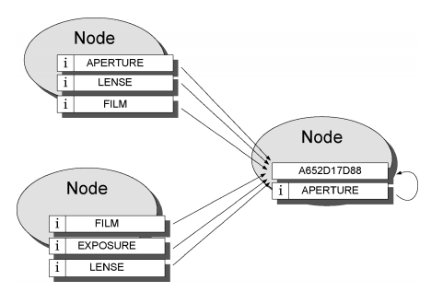
Loosely structure architecture
Indirect Files
A special class of lightweight files
Named according to search keywords
Contain pointers to the real file
Multiple files w/ the same key
Properties
Nodes specialize in searching for similar keys
Nodes store similar keys
Similarity of keys does not reflect similarity of files
Routing does not reflect the underlying network topology

Slide 31
structured architecture
Chord
CAN
Tapestry
Notes:
Chord is a system whose nodes maintain a distributed routing table in the form of an identifier circle on which all nodes are mapped, and an associated finger table.
CAN is a system using an n-dimensional Cartesian coordinate space to implement the distributed location and routing table, whereby each node is responsible for a zone in the coordinate space.
Tapestry (and the similar Pastry and Kademlia) are based on the plaxton mesh data structure, which maintains pointers to nodes in the network whose IDs match the elements of a tree-like structure of ID prefixes up to a digit position.

Slide 32
Chord
Notes:
Identifies data items (files) with keys and storing the (key, data item) pairs at the node that the keys map to
Keys are assigned both to files and nodes by means of a deterministic function – a variant of consistent hashing
All node identiﬁers are ordered in an “identiﬁer circle” modulo 2m. The picture shows an identiﬁer circle with m = 3
Key k is assigned to the ﬁrst node whose identiﬁer is equal to, or follows k,in the identiﬁer space. This node is called the successor node of key k. The use of consistent hashing tends to balance load, as each node receives roughly the same number of keys.
Mapping of file ID onto node ID
Node stores (key, data item)
Node is identified by keys
Key is assigned both to files and nodes
All node IDs are ordered in an identifier circle
Only routing information required is each node’s successor node

Slide 33
Chord
Additional Routing Information
finger table
Time required for lookups
O(N) -> O(logN)
Node 0 searches for id 5
Searches 5’s predecessor
Node is not 5’s predecessor
Scan finger table, search for the closest preceding finger
Node 3 is the first node that is between 0 and 5
Node 3 is 5’s predecessor
Node 3’s successor is returned

Slide 34
Content Addressable Network

Slide 35
Content Addressable Network
Hash Table
Maps file names to location
(key,value) pairs in the table
Support insertion, lookup, and deletion
Node stores a zone of the hash table
Cartesian coordinate space store (key K, value V) pairs
Key K is mapped onto a point P
Routing works by following the straight line path through Cartesian space.
A node Joins,
Allocated its portion by splitting the allocated zone of an existing node in half
A node leaves,
Hash table entry is handed over to one of its neighbors

Slide 36
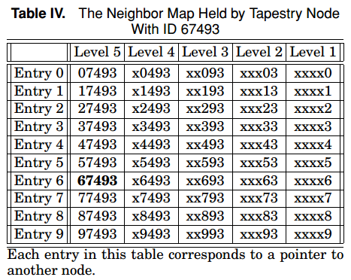
Tapestry
Network is self-organizing
Routing and Location Information is distributed among the network nodes
Plaxton mesh
Nodes take role of servers, routers and clients
Each node maintains a neighbor map
Level + Entry

Slide 37
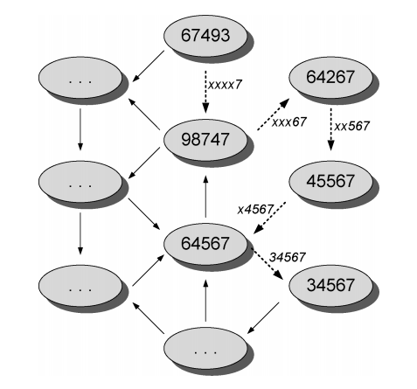
Tapestry
Messages route digit-by-digit
Example path taken by a message
node ID 67493 -> node ID 34567
Digits are resolved right to left
xxxx7->xxx67->xx567->x4567->34567

Slide 38
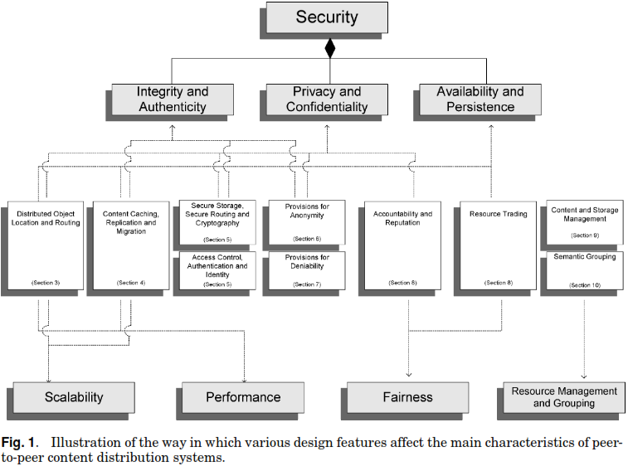

Slide 39
4 Content Caching, Replication and Migration
P2P content distribution systems rely on the replication of content for
Improving availability of Content
Enhancing Performance and
Resisting censorship attempts

Slide 40
Content Replication (1)
Passive Replication: Content replication occurs naturally as nodes request and copy content from one another.
Cache-based Replication: is the result of caching copies as it passes through the nodes.
Active Replication: (aka proactive) are employed to improve locality of data, as well as availability and performance.
Introspective Replica management: traffic is observed, and replicas of content objects are created to accommodate demand.
Dynamic replica management: dynamically place minimum number of replicas while meeting QoS and server capacity.

Slide 42
5 security
Due to their open and autonomous nature, P2P content distribution has the following challenges
Availability
Privacy
Confidentiality
Integrity
Authenticity
Network nodes must be considered as untrusted parties

Slide 43
5.1 secure storage (1)
Self-Certifying Data: a data whose integrity can be verified by the node retrieving it.
Information Dispersal: Files are encoded into $m$ blocks, so that any $n$ is sufficient to reassemble the original data ($m<n$).
Shamir’s Secret Sharing Scheme: publisher encrypts a file with any key $K$, then splits $K$ into $l$ shares, so that any $k$ of them can produce $K$, bur $k−1$ gives no hint about $K$.
Anonymous Cryptographic Relays: based on publisher, forwarder, storer and client
Publisher selects several forwarders and sends to them via anonymous connection, encrypted shares of files.
Forwarders select other nodes to act as storers for the shares and forwards the shares to them.
Publisher destroys them and announces the filename together with the list of forwarders, once the all the shares are stored.
Notes:
Various cryptographic algorithms and protocols are employed to provide a security for the content published and stored in p2p ntks.
Self-certifying data: a node inserting a file calculates a cryptographic hash of the files content, based on a knows hashing function, to produce the file key. When a node retrieves the file using its key, it calculates the same hash function to verify the integrity of the data.

Slide 44
5.1 secure storage (2)
Smartcards: used to track each node’s use of remote resources and issuing digitally signed tickets
Distributed Steganographic File Systems: encrypted blocks are indistinguishable from random substrate, so that their presence cannot even be detected.
Erasure Coding: data is broken into blocks and spread over many servers.
Only a fraction is need to reconstruct the original block

Slide 45
5.2 secure routing
Goal: resolve problem of malicious nodes attempting to corrupt, delete, deny access to, or supply stale copies of object replicas.
Problems to cope
Secure assignment of IDs to nodes
Secure maintenance of routing tables
Secure forwarding of messages

Slide 46
5.3 access control, authentication and identity management
Sybil Attack: Same physical entity appearing under different identities
This poses security threat, especially in P2P systems that employ content replication, or fragmentation schemes over many peers
Unless central Certification or identification authority is employed P2P are susceptible to sybil attack
Proposed Solution: resource-demanding identification challenges

Slide 48
6. Provisions for anonymity (1)
For privacy, confidentiality, and censorship
Anonymity: refers
Author (or publisher) of the content
Identity of a node storing the content
Identity and details of the content itself
Details of a query for retrieval of the content

Slide 49
6. Provisions for anonymity (2)
Disassociation of Content Source and Request: makes it infeasible to discover the true origin or destination of a file passing through its network and difficult for a node operator to determine or be held responsible for the actual content of their own node.
Anonymous Connection Layers: provide anonymous infrastructure
Censorship Resistant Lookup: provides censorship resistance by focusing on publisher, storer, and retriever anonymity, and by making it difficult for a node to voluntarily assume responsibility for a certain document[Chord].

Slide 51
7. provisions for deniability (1)
Definition: it refers to user’s ability to deny knowledge of content stored in their node
Users cannot be held responsible for
the content stored in their node, or
actions that have been carried out by their node as part of it’s operation
Deniable P2P system
Increases the degree of freedom it provides to its users
Makes the exchange of illegal content less risky and easier

Slide 52
7. provisions for deniability (2)
Deniability can apply to both content being stored and content being transferred
Deniability of Stored Content: is offered by systems that store encrypted shares of files and no keys for them, and therefore, cannot know the content of the files whose shares they are storing.
Deniability of Contents in Transit: offered through the use of anonymous connection layers
It makes it possible to deny that a request from a client node $nc$ had anything to do with a share arriving at$nc$sometime later.
Make it infeasible to discover the true origin of a file passing through the network.

Slide 54
8. Incentive mechanisms and accountability (1)
Uncontrolled decentralized P2P system relies to a large extent on the voluntary participation of its users
Necessary to provide incentives
Otherwise, from degradation of performance to complete system collapse may occur.
Free Rider: uncooperative behavior where users only consume resources without contributing any.

Slide 55
8. Incentive mechanisms and accountability (2)
Incentive Mechanisms
Trust-based Incentive Mechanisms: straight forward incentive mechanism for cooperation, in which one engages in a transaction based on whether s/he trust the other party. E.g., Reputation
Trade-based Incentive Mechanisms: one party offering some service to another is explcitly remunerated

Slide 56
8.1 Reputation mechanisms (1)
“Word-of-mouth-communities”
Individuals share opinions about other individuals
Centralized Reputation Systems: successful to a large extent
People trust the reputation information presented by them (eBay)
P2P Network: No single recognizable organization or entity to maintain and distribute reputation information.
Reputation information must be distributed throughout the network and hosted on many different nodes.

Slide 57
8.1 Reputation mechanisms (2)
Goal: take reputation generated locally and spread it throughout the network to produce global reputation of network nodes
Suggested Reputation Management Mechanisms
Compute users’ global reputation ratings based on their history of uploads.
Partially Centralized mechanisms using reputation computation agents
Feedback-based reputation mechanisms
Using node logs

Slide 58
8.2 MICROPAYMENT MECHANISM
In MojoNation, a currency(“Mojo”) is gained by offering disk space, bandwidth, or CPU cycles.
Mojo is used to obtain access to distributed storage space.

Slide 59
8.3 RESOURCE TRADING SCHEME
Each node publishes and digitally signs logs containing
Lists of files it stores on behalf of remote nodes
Lists of files that other nodes are storing on its behalf
No node is using more resources than it is providing
In FreeHaven, nodes form contracts to store each other’s material for a certain period of time
Fulfilling a contract -> increase in reputation
Dropping data earlier -> decrease in reputation

Slide 61
9. Resource management (1)
P2P content distribution systems resources
Content (files)
Storage (Disk space)
Transmission Capacity (Bandwidth)
Minimum Operations: Inserting, Locating (searching)
Additional Resource Management Facilities: Retrieving, Removing, Updating, Maintaining previous update, Managing storage space, Setting bandwidth limits.

Slide 62
9. Resource management (2)
Content Deletion and Update
Not Straight-forward if synchronization is to be maintained.
Immutable files cannot be updated and posting a new version of document under different name[MojoNation].
PAST: also offers delete operation but no guarantee that the file will no longer be available anywhere in the network.

Slide 63
9. Resource management (3)
Other Resource Management
Content Sharing
Content Versioning
Directory Structure
Content Searching
Storage and Bandwidth management

Slide 65
10. semantic grouping of information
Interest-based «Peer Communities»
Membership depends on the relationship between peers that share common interest.
Efficient searching and better quality of results
Semantic Overlay Clustering
Based on partially-centralized (super-peer) networks
Creates logical layers above the physical network topology, by matching semantic information provided by peers

Slide 66
Thank you for your attention!

