Slide 1
TreadMarks: Distributed Shared Memory on Standard Workstations and Operating Systems
Pete Keleher, Alan L. Cox, Sandhya Dwarkadas and Willy Zwaenepoel
Department of Computer Science, Rice University
Winter Usenix Conference, 1994
Joongsuk Park, Hanggi Choi
Disclaimer: Many parts of this slide are brought from previous classes in distributed information processing classes @SNUCSE.

Slide 2
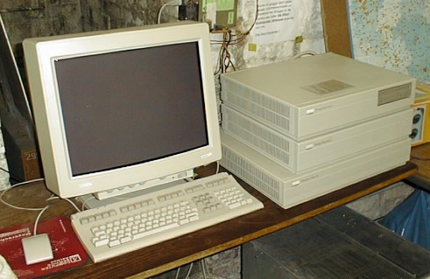
Big Picture
Distributed Shared Memory
ATM
Benchmark (speedup)
- Jacobi (x7.4)
- TSP (x7.2)
- Quicksort (x6.3)
- ILINK (x5.7)
- Water (x4.0)
Ethernet

Slide 3
Contents
Overview
Preliminaries: why
Introduction
Release Consistency
Eager Release Consistency(ERC)
Lazy Release Consistency(LRC)
Multiple-Writer Protocol
Lazy Diff Creation
Implementations: how
Experiments

Slide 4
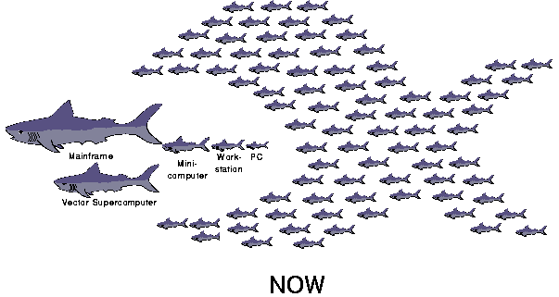
Cluster of Workstations vs. Supercomputers
[Kleinrock85] L. Kleinrock, "Distributed Systems," Communications of the ACM (CACM) Vol. 28, No.11, November 1985, pp. 1200-1213
low-cost entry into parallel computing arena
No special HW is required

Slide 5
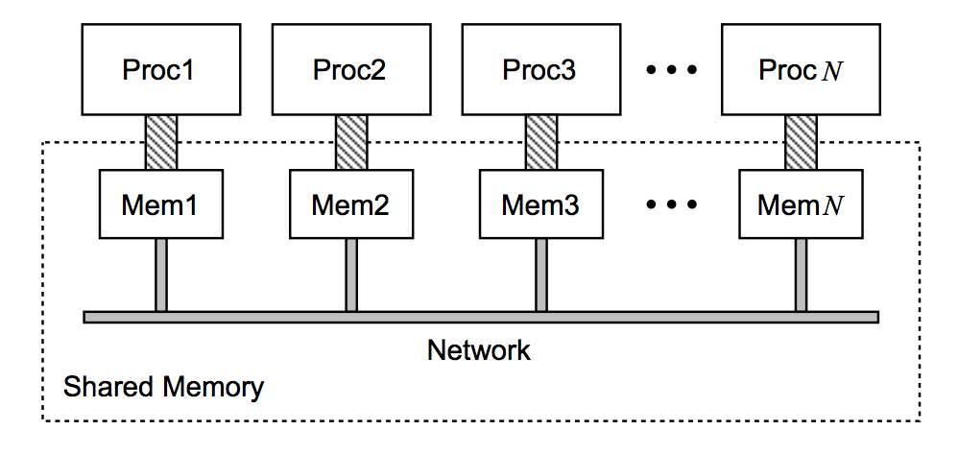
Distributed Shared Memory
DMS is a form of memory architecture where the (physically separate) memories can be addressed as one (logically shared) address space
Easier to program than MPI
High cost of communication
Notes:
RMI (Remote Message Invocation)

Slide 6
Problems of DMS
Lack of Portability
Hardware
In-house research platforms
Software
Kernel modifications
Poor Performance
Communication overhead
False sharing

Slide 7
Problems of DMS
Lack of Portability
Hardware
In-house research platforms -> Standard Unix Systems Platforms
Software
Kernel modifications -> User-level implementation
Poor Performance
Communication overhead -> Lazy Release Consistency
False sharing -> Multiple Writer Protocols

Slide 8
Release Consistency
Release Consistency (RC) is a relaxed memory consistency model that permits a processor to delay making its changes to shared data visible to other processors until certain synchronization access occur
Shared memory access
Ordinary
Synchronized Accesses
Acquire access
Release access

Slide 9
Release Consistency
P1:
a1: acq(L)
data access
r1: rel(L)
P2:
a2: acq(L)
data access
r2: rel(L)
If P1:r1 happened before P2:a2
- All coherence actions prior to P1:r1 should be complete before P2:a2

Slide 10
Release Consistency
Two Types of RC
Eager Release Consistency (ERC)
Lazy Release Consistency (LRC)

Slide 11
Eager Release Consistency
Push Model

Slide 12
Lazy Release Consistency
Pull Model

Slide 13
Multiple Writer Protocols
To solve False sharing Problem => Multiple writer protocol
- Several processes make modifications to different variables at the same page
Proc 1
Proc 2
 | Var x |  | Var y
page

Slide 14
Multiple Writer Protocol
Two method
Twin
1. Copy original page
2. Compared original page and changed page
Diff
Difference between twin and copyset
twin
Write P
Diff
Writable working copy

Slide 15
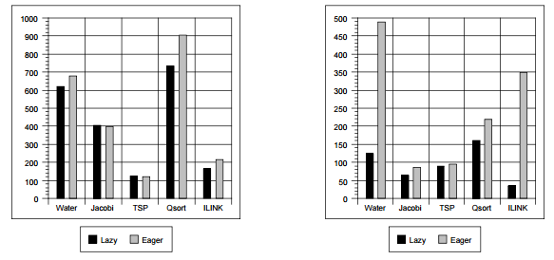
Lazy Diff Creation
In TreadMarks, Diff created
Modifications to a page
Write notice from another process
Different from Munin’s implementation
Diff creation postponed until the modification are requested
Reduce the number of diff created
Diff Creation Rate

Slide 16
Contents
Overview
Preliminaries: why
Implementations: how
Data structure
Interval and diff creation
Lock and barriers
Access Misses, garbage collection and Unix aspects
Experiments

Slide 17
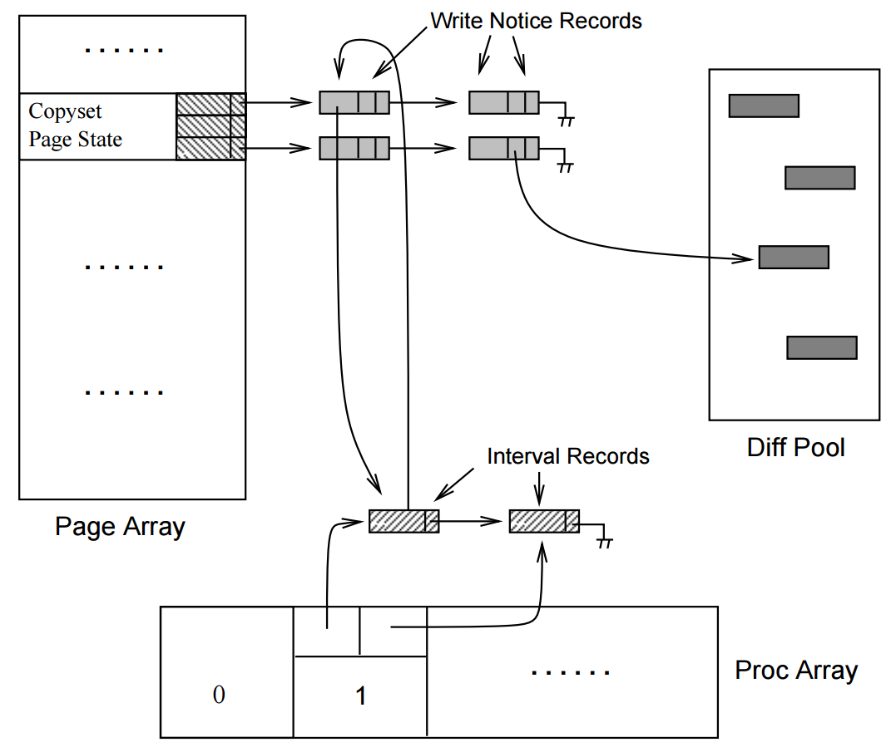
Data Structure Overview

Slide 18
Data Structure Overview
Page Array
One entry for each shared page
Current status
No access, read-only, read-write
Approximate copyset
Specifying the set of processors that are believed to currently cache this page

Slide 19
Data Structure Overview
Page Array
One entry for each shared page
Current status
No access, read-only, read-write
Approximate copyset
Specifying the set of processors that are believed to currently cache this page
Array indexed by processor
Head and tail pointers to linked list of write notice records

Slide 20
Data Structure Overview
Proc Array
One entry for each processor
Pointer to the head and tail of a doubly linked list of interval records

Slide 21
Data Structure Overview
Proc Array
One entry for each processor
Pointer to the head and tail of a doubly linked list of interval records
Interval Records
Pointer to a list of write notice records for that interval

Slide 22
Data Structure Overview
Diff pool
store diffs for corresponding write notice records
Write notice records has a pointer for the diffs in diff pool

Slide 23
Example
P0
R
0
Process 0
P0
I
0
Process 1
Page Data
1
1
2
Page Array
2
3
3
P1
R
0
P1
I
0
1
1
2
2
3
Interval
3
<0,0,0,0>
0
<0,0,0,0>
<0,0,0,0>
0
<0,0,0,0>
Timestamp
1
<0,0,0,0>
1
<0,0,0,0>
2
<0,0,0,0>
2
<0,0,0,0>
Proc Array
3
<0,0,0,0>
3
<0,0,0,0>
P0
I
0
Process 2
P0
I
0
Process 3
1
1
2
2
3
3
P1
I
0
P1
I
0
1
1
2
2
3
3
<0,0,0,0>
0
<0,0,0,0>
<0,0,0,0>
0
<0,0,0,0>
1
<0,0,0,0>
1
<0,0,0,0>
2
<0,0,0,0>
2
<0,0,0,0>
3
<0,0,0,0>
3
<0,0,0,0>

Slide 24
Example
P0
R
0
Process 0
P0
R
0
Process 1
1
1
2
2
3
3
P1
R
0
P1
I
0
1
1
Proc 1 reads Page 0
2
2
3
3
Assumption: initially the pages are stored at process 0
Fetch the data from Process 0
The page status is modified to readable
TreadMarks structure is not modified
<0,0,0,0>
0
<0,0,0,0>
<0,0,0,0>
0
<0,0,0,0>
1
<0,0,0,0>
1
<0,0,0,0>
2
<0,0,0,0>
2
<0,0,0,0>
3
<0,0,0,0>
3
<0,0,0,0>
P0
I
0
Process 2
P0
I
0
Process 3
1
1
2
2
3
3
P1
I
0
P1
I
0
1
1
2
2
3
3
<0,0,0,0>
0
<0,0,0,0>
<0,0,0,0>
0
<0,0,0,0>
1
<0,0,0,0>
1
<0,0,0,0>
2
<0,0,0,0>
2
<0,0,0,0>
3
<0,0,0,0>
3
<0,0,0,0>

Slide 25
Example
P0
RW
0
w0
Process 0
P0
R
0
Process 1
1
1
2
2
3
3
P1
R
0
P1
I
0
1
1
Proc 1 reads Page 0
Proc 0 writes Page 0
2
2
3
3
<0,0,0,0>
0
<0,0,0,0>
<0,0,0,0>
0
<0,0,0,0>
The copy of page 0 is created
The update is applied to the copied data
Processors are not yet synchronized
The update is not propagated to other processors
1
<0,0,0,0>
1
<0,0,0,0>
2
<0,0,0,0>
2
<0,0,0,0>
3
<0,0,0,0>
3
<0,0,0,0>
P0
I
0
Process 2
P0
I
0
Process 3
1
1
2
2
3
3
P1
I
0
P1
I
0
1
1
2
2
3
3
<0,0,0,0>
0
<0,0,0,0>
<0,0,0,0>
0
<0,0,0,0>
1
<0,0,0,0>
1
<0,0,0,0>
2
<0,0,0,0>
2
<0,0,0,0>
3
<0,0,0,0>
3
<0,0,0,0>

Slide 26
Example
P0
RW
0
w0
Process 0
P0
RW
0
Process 1
1
1
w0
2
2
3
3
P1
R
0
P1
I
0
1
1
Proc 1 reads Page 0
Proc 0 writes Page 0
Proc 1 writes Page 0
2
2
3
3
<0,0,0,0>
0
<0,0,0,0>
<0,0,0,0>
0
<0,0,0,0>
1
<0,0,0,0>
1
<0,0,0,0>
2
<0,0,0,0>
2
<0,0,0,0>
Multiple-Writer enables
concurrent update to same page
Different variables in the same page:
Concurrent Multiple-Writer update
Same variable in the same page:
Explicit barrier or lock
3
<0,0,0,0>
3
<0,0,0,0>
P0
I
0
Process 2
P0
I
0
Process 3
1
1
2
2
3
3
P1
I
0
P1
I
0
1
1
2
2
3
3
<0,0,0,0>
0
<0,0,0,0>
<0,0,0,0>
0
<0,0,0,0>
1
<0,0,0,0>
1
<0,0,0,0>
2
<0,0,0,0>
2
<0,0,0,0>
3
<0,0,0,0>
3
<0,0,0,0>

Slide 27
Example
P0
RW
0
w0
Process 0
P0
RW
0
Process 1
1
1
w0
2
2
3
3
P1
R
0
P1
I
0
1
1
Proc 1 reads Page 0
Proc 0 writes Page 0
Proc 1 writes Page 0
Proc 2 reads Page 0
2
2
3
3
<0,0,0,0>
0
<0,0,0,0>
<0,0,0,0>
0
<0,0,0,0>
1
<0,0,0,0>
1
<0,0,0,0>
2
<0,0,0,0>
2
<0,0,0,0>
3
<0,0,0,0>
3
<0,0,0,0>
Fetch data from Process 0
The write notice record for page 0 is not propagated
The updates are not visible
P0
R
0
Process 2
P0
I
0
Process 3
1
1
2
2
3
3
P1
I
0
P1
I
0
1
1
2
2
3
3
<0,0,0,0>
0
<0,0,0,0>
<0,0,0,0>
0
<0,0,0,0>
1
<0,0,0,0>
1
<0,0,0,0>
2
<0,0,0,0>
2
<0,0,0,0>
3
<0,0,0,0>
3
<0,0,0,0>

Slide 28
Example
P0
RW
0
w0
Process 0
P0
RW
0
Process 1
1
1
w0
2
2
3
3
P1
R
0
P1
I
0
1
1
Proc 1 reads Page 0
Proc 0 writes Page 0
Proc 1 writes Page 0
Proc 2 reads Page 0
Proc 0 writes Page 0
2
2
3
3
<0,0,0,0>
0
<0,0,0,0>
<0,0,0,0>
0
<0,0,0,0>
1
<0,0,0,0>
1
<0,0,0,0>
2
<0,0,0,0>
2
<0,0,0,0>
3
<0,0,0,0>
3
<0,0,0,0>
Page 0 modification is already notified
Lazy diff creation enables process 0 keep writing data on page 0
without modifying TreadMarks structure
P0
R
0
Process 2
P0
I
0
Process 3
1
1
2
2
3
3
P1
I
0
P1
I
0
1
1
2
2
3
3
<0,0,0,0>
0
<0,0,0,0>
<0,0,0,0>
0
<0,0,0,0>
1
<0,0,0,0>
1
<0,0,0,0>
2
<0,0,0,0>
2
<0,0,0,0>
3
<0,0,0,0>
3
<0,0,0,0>

Slide 29
Example
P0
I
0
w0
Process 0
P0
I
0
w0
Process 1
1
w0
1
w0
2
2
3
3
P1
R
0
P1
I
0
1
1
Proc 1 reads Page 0
Proc 0 writes Page 0
Proc 1 writes Page 0
Proc 2 reads Page 0
Proc 0 writes Page 0
Barrier
2
2
3
3
<1,1,1,1>
0
<1,1,1,1>
<0,0,0,0>
<1,1,1,1>
0
<1,1,1,1>
<0,0,0,0>
1
<1,1,1,1>
<0,0,0,0>
1
<1,1,1,1>
<0,0,0,0>
2
<1,1,1,1>
<0,0,0,0>
2
<1,1,1,1>
<0,0,0,0>
3
<1,1,1,1>
<0,0,0,0>
3
<1,1,1,1>
<0,0,0,0>
P0
I
0
w0
Process 2
P0
I
0
w0
Process 3
New interval is created and vector time stamp is updated
Synchronization data (interval, write notice) is propagated
Modified pages are changed into invalidate
Actual diff is created
Actual written data is not propagated
1
w0
1
w0
2
2
3
3
P1
I
0
P1
I
0
1
1
2
2
3
3
<1,1,1,1>
0
<1,1,1,1>
<0,0,0,0>
<1,1,1,1>
0
<1,1,1,1>
<0,0,0,0>
1
<1,1,1,1>
<0,0,0,0>
1
<1,1,1,1>
<0,0,0,0>
2
<1,1,1,1>
<0,0,0,0>
2
<1,1,1,1>
<0,0,0,0>
3
<1,1,1,1>
<0,0,0,0>
3
<1,1,1,1>
<0,0,0,0>

Slide 30
Example
P0
I
0
w0
Process 0
P0
I
0
w0
Process 1
1
w0
1
w0
2
2
3
3
P1
R
0
P1
I
0
1
1
Proc 1 reads Page 0
Proc 0 writes Page 0
Proc 1 writes Page 0
Proc 2 reads Page 0
Proc 0 writes Page 0
Barrier
Proc 3 reads Page 0
2
2
3
3
<1,1,1,1>
0
<1,1,1,1>
<0,0,0,0>
<1,1,1,1>
0
<1,1,1,1>
<0,0,0,0>
1
<1,1,1,1>
<0,0,0,0>
1
<1,1,1,1>
<0,0,0,0>
2
<1,1,1,1>
<0,0,0,0>
2
<1,1,1,1>
<0,0,0,0>
3
<1,1,1,1>
<0,0,0,0>
3
<1,1,1,1>
<0,0,0,0>
P0
I
0
w0
Process 2
P0
R
0
w0
Process 3
1
w0
1
w0
Actual written data (diff) is transferred when the data is actually required
The necessary diffs could be tracked based on TreadMarks structure
2
2
3
3
P1
I
0
P1
I
0
1
1
2
2
3
3
<1,1,1,1>
0
<1,1,1,1>
<0,0,0,0>
<1,1,1,1>
0
<1,1,1,1>
<0,0,0,0>
1
<1,1,1,1>
<0,0,0,0>
1
<1,1,1,1>
<0,0,0,0>
2
<1,1,1,1>
<0,0,0,0>
2
<1,1,1,1>
<0,0,0,0>
3
<1,1,1,1>
<0,0,0,0>
3
<1,1,1,1>
<0,0,0,0>

Slide 31
Example
P0
I
0
Process 0
P0
I
0
Process 1
1
1
2
2
3
3
P1
R
0
P1
I
0
1
1
Proc 1 reads Page 0
Proc 0 writes Page 0
Proc 1 writes Page 0
Proc 2 reads Page 0
Proc 0 writes Page 0
Barrier
Proc 3 reads Page 0
2
2
3
3
<1,1,1,1>
0
<1,1,1,1>
<1,1,1,1>
0
<1,1,1,1>
1
<1,1,1,1>
1
<1,1,1,1>
2
<1,1,1,1>
2
<1,1,1,1>
3
<1,1,1,1>
3
<1,1,1,1>
P0
I
0
Process 2
P0
R
0
Process 3
1
1
Garbage collector is triggered when available memory is low
Garbage collector removes unnecessary data
2
2
3
3
P1
I
0
P1
I
0
1
1
2
2
3
3
<1,1,1,1>
0
<1,1,1,1>
<1,1,1,1>
0
<1,1,1,1>
1
<1,1,1,1>
1
<1,1,1,1>
2
<1,1,1,1>
2
<1,1,1,1>
3
<1,1,1,1>
3
<1,1,1,1>

Slide 32
Implementation Details
Interval Creation
Logically a new interval begins at each release and acquire
Practically interval creation is postponed until the communication occur
Diff creation
Lazy diff creation
Page is writable until a diff request or a write notice arrives for the page
At that time, the actual diff is created, the page is read protected, and the twin is discarded

Slide 33
Implementation Details
Lock
Barrier
A statically assigned manager
acquired round-robin fashion
Releaser informs the synchronization information
Processor id
Vector timestamp
All write notices
Acquirer incorporates this information into its own data structure
Append interval record
Append write-notice and update pointers
A centralized manager
All clients informs its vector timestamp and intervals between the manager’s last timestamp and its own time stamp
After gathering all synchronization information, the manager informs all clients of all intervals between their time stamp and its current stamp
The clients incorporates this information into its own data structure

Slide 34
Implementation Details
Access Misses
Initially assumed that process 0 has the page
If there are some write notices
Gather the write notices which have larger timestamp
Sending query to the diffs in parallel
Merge the query into the page
Garbage collection
Discards unnecessary data
Triggered when the available storage is dropped below a threshold
TreadMarks relies on Unix standard

Slide 35
Contents
Overview
Preliminaries: why
Implementations: how
Experiments
Environment
Basic Operations Costs
Applications
Results

Slide 36
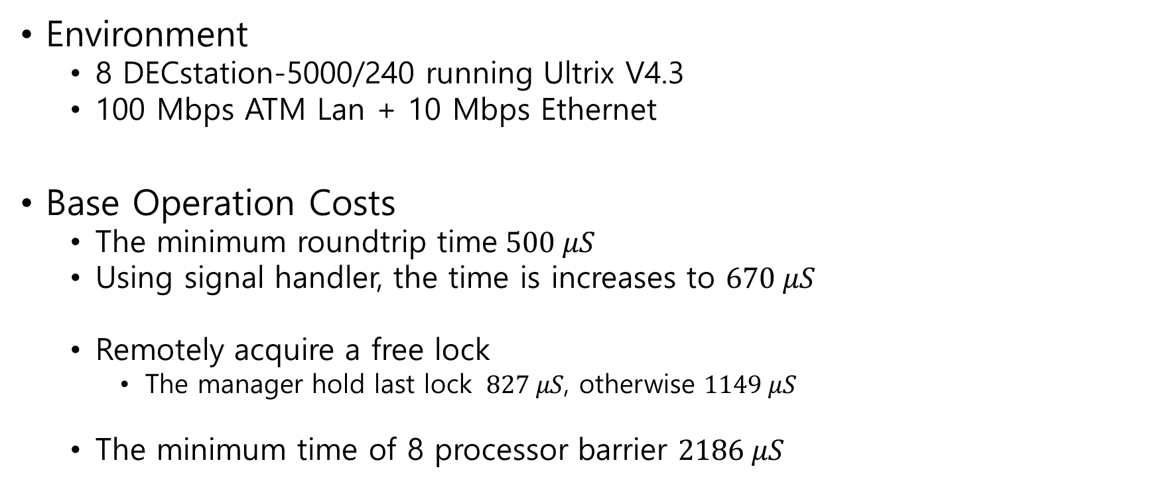
Results
Environment
8 DECstation-5000/240 running Ultrix V4.3
100 Mbps ATM Lan + 10 Mbps Ethernet
Base Operation Costs
The minimum roundtrip time$500 μS$
Using signal handler, the time is increases to $670 μS$
Remotely acquire a free lock
The manager hold last lock $827 μS$, otherwise $1149 μS$
The minimum time of 8 processor barrier $2186 μS$

Slide 37
Experiments
Applications
Water – molecular dynamics simulation, 343 molecules for 5 steps
Jacobi – Success Over-Relaxation with a grid of 2000 by 1000 elements
TSP – branch & bound algorithm to solve the traveling sales man problem for a 19 cities
Quicksort – sort an array of 256K integers. Using bubble sort to sort subarray of less than 1K elements
ILINK – genetic linkage analysis

Slide 38
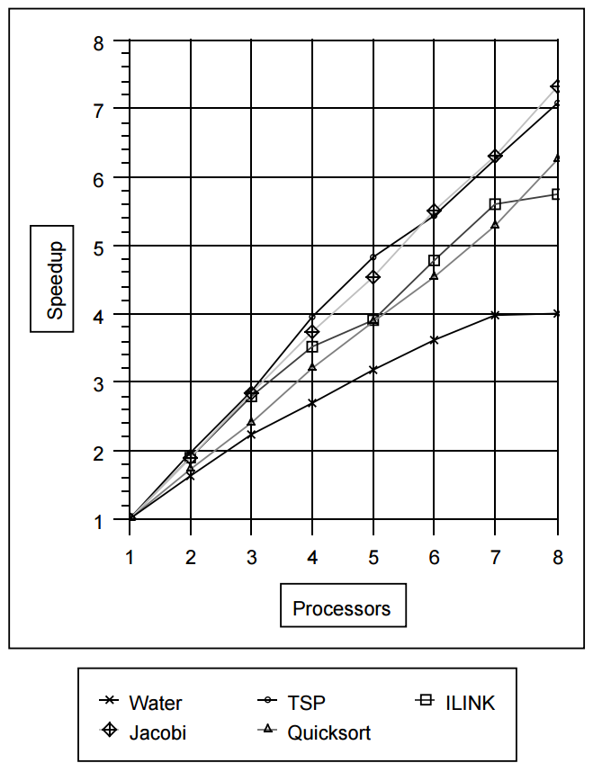
Results
Execution Statistics for an 8-Processor Run on TreadMarks
Jacobi & TSP
High computation per communication
Small # of messages
Quicksort
Twice larger massages and data per second than Jacobi’s
ILINK
Inherent load balancing problem
Water
High communication and synchronization rate (582 lockssec)
Speed up obtained on TreadMarks

Slide 39
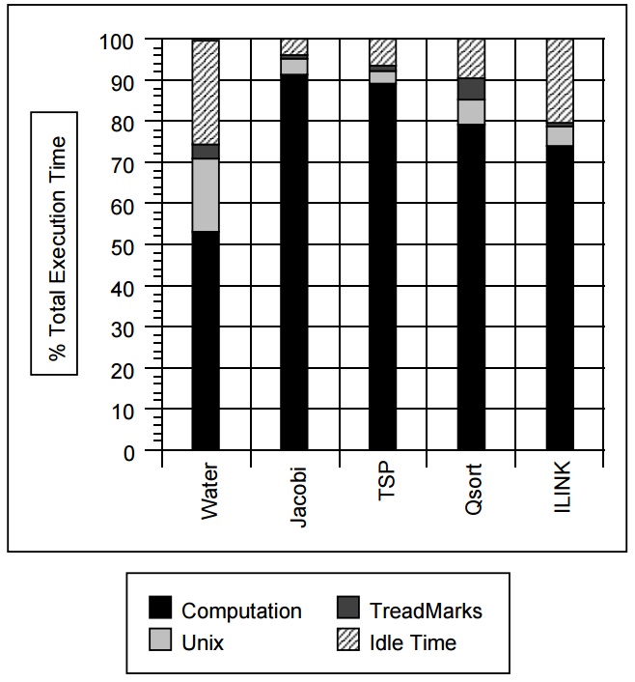
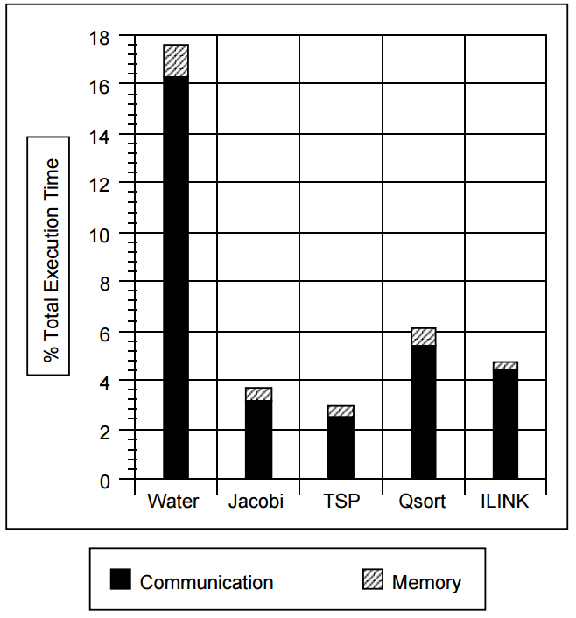
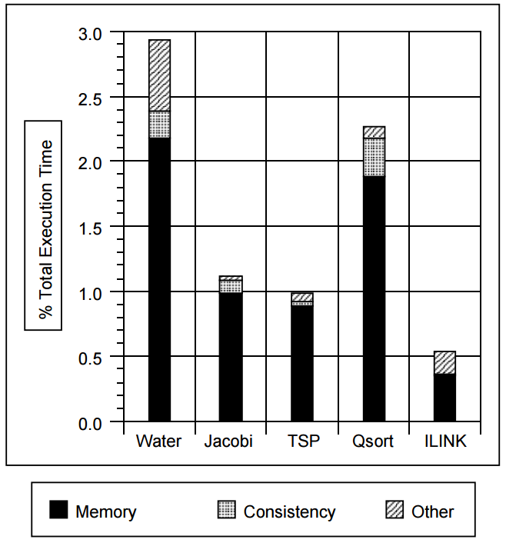
Results
TreadMarks Execution Time Breakdown
Unix Overhead Breakdown
TreadMarks Overhead Breakdown

Slide 40
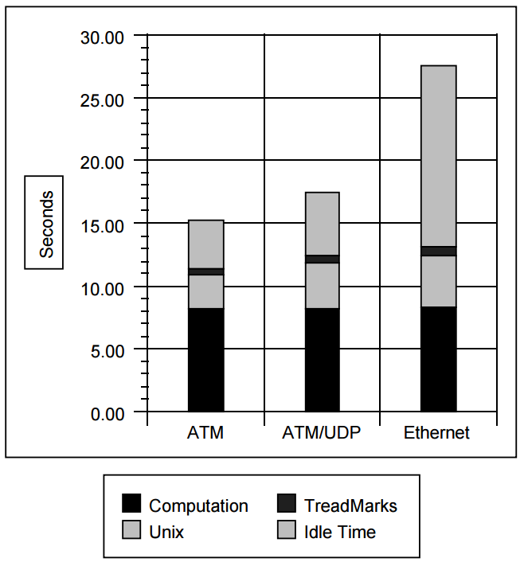
Results
Execution time for Water

Slide 41
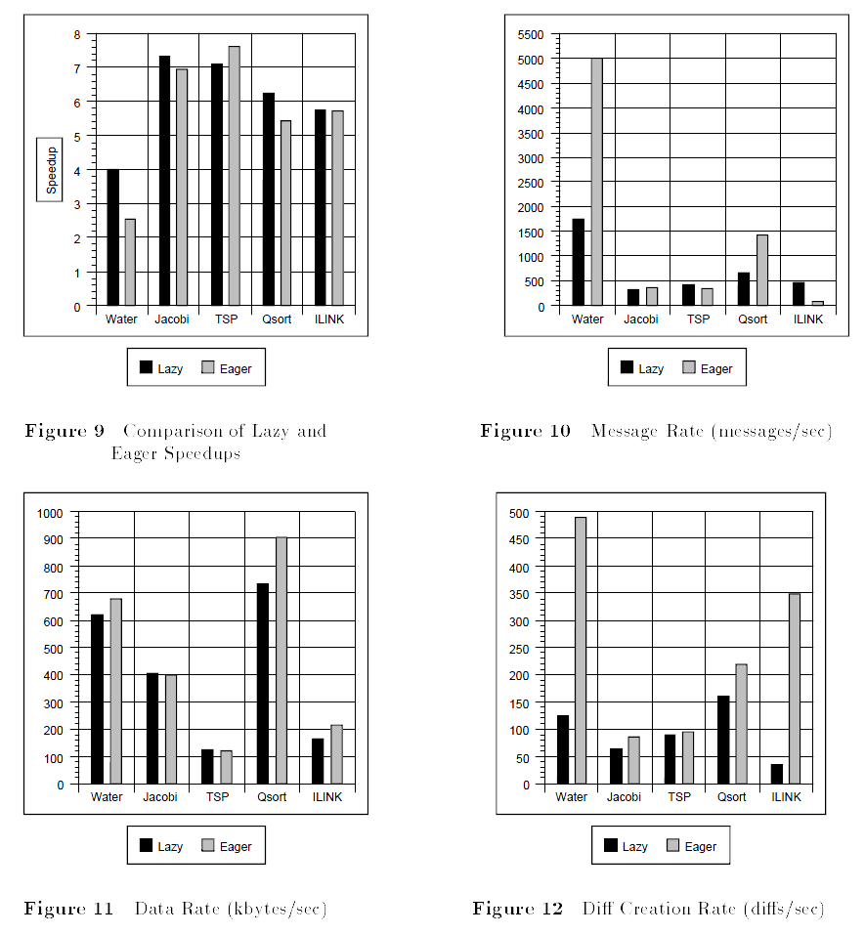
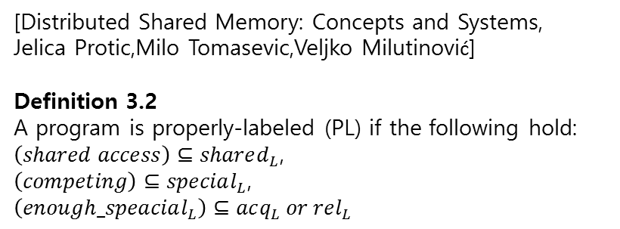
Results
[Distributed Shared Memory: Concepts and Systems,
Jelica Protic,Milo Tomasevic,Veljko Milutinović]
Definition 3.2
A program is properly-labeled (PL) if the following hold:
$\left(shared access\right)⊆shared_{L}$,
$\left(competing\right)⊆special_{L}$,
$$\left(enough_speacial_{L}\right)⊆acq_{L} or rel_{L}$$
TSP: Traveling Salesperson Problem
Branch and Bound: pruned version of DFS
Lazy >> Eager
Lazy < Eager
Branch and Bound is not properly labeled program

Slide 42
Conclusion
DSM as a platform for parallel computation
Efficiency
User-level implementations
Commercial systems
Implementation
Eight DECstation-5400/240’s connected to a ATM/Ethernet LAN
Lazy RC, multiple-writer, lazy diff creation
Good speedups for Jacobi, TSP, Quicksort and ILINK
Moderate speedups for Water

