Slide 1
Memory coherence in shared virtual memory systems
Presenters:
Johnathon T. Soulis, Nushaba Gadimli

Slide 2
Outline
Shared virtual memory
Centralized manager algorithms
Distributed manager algorithms
Experiments
Concluding remarks
Notes:
Briefly explain the topics to be discussed in this presentation.

Slide 3
Shared Virtual Memory
A single address space shared by a number of processors.
Partitioned into pages.
Any processor can access any memory location in the address space directly.
Memory mapping managers implement the mapping between the local memories and the shared virtual address space.
Notes:
A shared virtual memory is essentially an address space shared by any number of processors. The structure is partitioned into “pages”. Application programs can use the shared virtual memory just as they do a traditional virtual memory, except, of course, that processes can run on different processors in parallel. The shared virtual memory not only “pages” data between physical memories and disks, as in a conventional virtual memory system, but it also “pages” data between the physical memories of the individual processors. Thus data can naturally migrate between processors on demand. Memory mapping managers implement the mapping between the local memories and the shared virtual address space.

Slide 4
Memory Mapping Manager
Implements the mapping between local memories and the shared virtual memory address space.
Ensure the address space is coherent
In other words, the value returned by a read operation is always the same as the value written by the most recent write operation to the same address.
Notes:
The memory mapping manger views its local memory as a large cache of the shared virtual memory address space for its associated processor. Like the traditional virtual memory, the shared memory itself exists only virtually. A memory reference causes a page fault when the page containing the memory location is not in a processor’s current physical memory. When this happens, the memory mapping manager retrieves the page from either disk or the memory of another processor. If the page of the faulting memory reference has copies on other processors, then the memory mapping manager must do some work to keep the memory coherent and then continue the faulting instruction. The way in which this is handled depends on the type of algorithm used. We will discuss centralized and distributed manager algorithms that were explored in this paper.

Slide 5
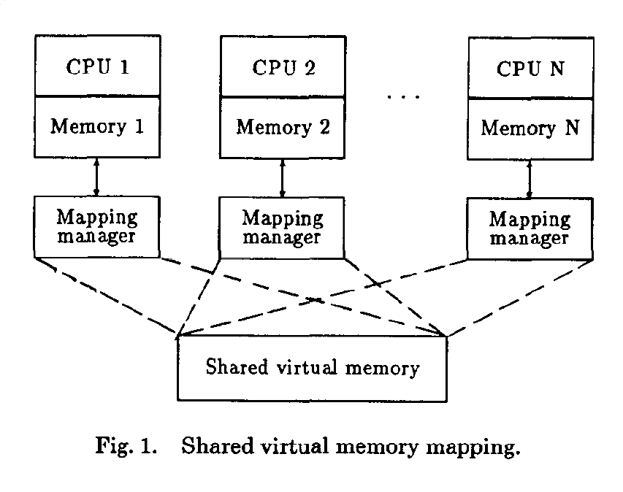
Notes:
As you can see, the shared virtual memory address space is shared by all of the different processors. The mappings between the local memories of the different processors is managed by the mapping manager that exists per process. One of the key goals of the shared virtual memory, of course, is to allow processes of a program to execute on different processors in parallel. Something to keep in mind when looking at this system, is that each processor also has multiple processes that are running concurrently with their own local virtual address space. The virtual address space is effectively the only way in which the different independent processors can communicate with each other.

Slide 6
Pages
Read Only
Write
Multiple copies can reside in the physical memories of many processors at once.
Can reside in only one processor’s physical memory
Notes:
As was mentioned previously, the shared virtual memory address space is separated into blocks called ‘Pages’ in which the different processors can either read or write. There are two different types of pages, namely Read Only and Write Pages. Pages marked as read only can be copied to multiple different processors at the same time for reading operations whereas pages marked as Write must only be copied to one processor’s physical memory at a given time to avoid memory coherence issues.

Slide 7
Memory Coherence Problem
Shared Virtual Memory
Multicache Systems
Processors share a physical memory via their private caches.
Time cost to resolve conflicting writes is small.
No shared physical memory.
Communication cost between processors is nontrivial.
Notes:
Memory coherence is a problem that is presented in a shared virtual memory system. You can imagine that if one processor is reading from an outdated copy of a page that has been written to we would see an inconsistency in expected results. This problem may resemble coherence issues that exist for multicache multiprocessors, but there is a notable difference. For multicache systems, usually a number of processors are sharing a physical memory through their private caches. Since the size of a cache is relatively small and the bus connecting it to the shared memory is fast, a sophisticated coherence protocol is usually implemented in the multicache hardware such that the time delay of conflicting writes to a memory location is small. On the other hand, a shared virtual memory system has no shared physical memory, so the communication cost between processors is nontrivial. Thus conflicts are not likely to be solved with a negligible delay of time. Thus as we will see, the strategy we employ for handling memory coherence issues when designing a shared virtual system is very important.

Slide 8
Implementation Design Choices
Granularity (page size)
Overhead of sending small and large amount of data is similar.
As page size increases contention issues increase.
Tradeoff introduced.
~1K bytes page size used in this paper
Memory coherence strategy
Notes:
The two design choices discussed in this paper include granularity, or the size of the page in the shared virtual address space, and the actual strategy for maintaining memory coherence. A tradeoff is introduced when considering how large to adjust the page size. The overhead for data transfer of a small versus a large page is pretty similar so it would make sense to increase the page size to have more data available and take advantage of spacial locality. On the other hand, as the page size increases so does the chance for contention, or the potential conflict for the page resource. You can imagine that if one processor needs to read from a given address and another process needs to write and both of these addresses exist on the same page because of how large the page size is that we may run into an issue.

Slide 9
Implementation Design Choices
Memory Coherence Strategies
Page Synchronization
Page Ownership
Invalidation
Write Broadcast
Fixed
Dynamic
Only one owner process of page. Copies of page that are distributed are invalidated before writes occur.
Writes are carried out on all copies of the page.
Page always owned by same processor. Other processes must negotiate with owner to read and write on page.
Page ownership changes. There are centralized and distributed strategy.
Notes:
The memory coherence problem can be addressed in terms of how we handle page synchronization and page ownership. There are two basic approaches to page synchronization which includes invalidation and write broadcast. In the invalidation approach, there is only one owner processor per page. This processor has either write or read access to the page. If another processor has a write fault to this page, the fault handler then invalidates all copies of the page of interest, changes the access of the page to write, moves a copy of the page to the requesting processor (if it does not already have one) and then returns to the faulting instruction. After returning, the requesting processor now owns that page and can proceed with the other operations until the ownership is relinquished to some other processor. In the write-broadcast approach, a processor treats reads similarly as in the invalidation approach, but writes are carried out on all copies of the page. This approach is too expensive to be practical.

Slide 10
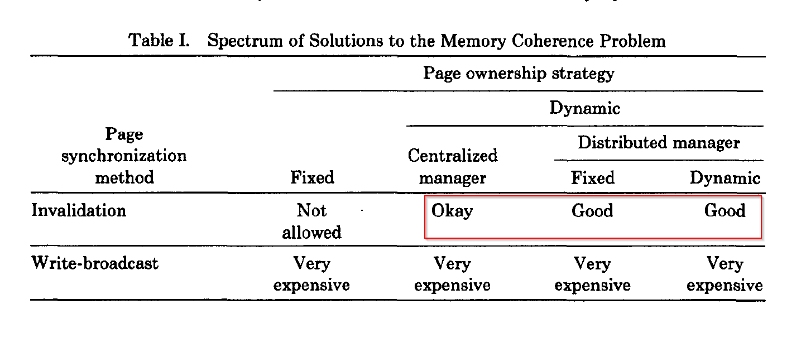
Memory Coherence Strategies
Notes:
We only consider algorithm based on invalidation using either a centralized manager, fixed distributed manager or dynamic distributed manager as the other choices are not practicle.

Slide 11
Centralized Manager Algorithms
A monitor-like centralized manager algorithm
An improved centralized manager algorithm
PART I
Notes:
Now that I have set up the foundations of the discussion, I will move to discuss the Centralized Manager Algorithms discussed in this paper with regards to shared virtual memory systems.

Slide 12
Monitor-like Centralized Algorithm
Manager resides on a single processor.
Maintains ‘Info’ table that has info for each page
Owner – single processor that owns page
Copy set – lists processors that have copy of page
Lock – used to synchronize page requests
Each processor has page table, ‘PTable’
Access – indicates accessibility of page
Lock – synchronization for page faults & requests
Notes:
For the monitor-like centralized algorithm, the manager resides on a single process. The manager keeps track of the owner of each shared virtual memory page as well as which processors currently have a copy of a given page. Each individual processor has a page table that indicates the access state and lock of a given page locally on the processor.

Slide 13
Monitor-like Centralized Algorithm (Cont’)
Page does not have fixed owner.
All requests go through manager.
Only one manager process that is aware of page/processor ownership.
Page owners send out copy of page to processors requesting read copy.
When read or write is finished a confirmation message is sent
Notes:
In this algorithm, a page does not have a fixed owner, and there is only one manager that knows who the owner is at a given time. The owner of the page send a copy to processors requesting a read copy. As long as a read copy exists out on other processors, the page is not writeable without an invalidation operation, which causes invalidation messages to be sent to all of the processors containing read copies. This information is known by the owner process via the Copy set table. When a processor finishes a read or write request, a confirmation message is sent to the manager to indicate completion of the request.

Slide 14
Monitor-like Centralized Algorithm (Cont’)
Consider Read Fault on P3 and assume this is the initial state of the system
P1
P2
P3
Info
Owner | P2
Copy set | {P1}
Lock | 0
PTable
Access | R
Lock | 0
PTable
Access | R
Lock | 0
PTable
Access
Lock | 0
Notes:
This is the initial state of the system. As we can see, the page of interest is owned by P2 and a copy of it exists on P1. Thus we can see that P2 has read access as well as P1 on this page. Lets imagine that a read Fault for this page occurs on P3.

Slide 15
Monitor-like Centralized Algorithm (Cont’)
1. Ask manager for read access and a copy
P1
P2
P3
Info
Owner | P2
Copy set | {P1}
Lock | 0
PTable
Access | R
Lock | 0
PTable
Access | R
Lock | 0
PTable
Access
Lock | 1
Notes:
Following the algorithm, the first step that occurs is that the faulting process, P3 requests read access and a copy of the page. It then puts a lock on itself so that no other faults proceed.

Slide 16
Monitor-like Centralized Algorithm (Cont’)
1. Ask manager for read access and a copy
P1
2. Request copy to be send to P3
P3
P2
Info
Owner | P2
Copy set | {P1,P3}
Lock | 1
PTable
Access | R
Lock | 1/0
PTable
Access | R
Lock | 0
PTable
Access
Lock | 1
Notes:
P1 is the manager but because it is not the owner, the Ptable is locked and then immediately unlocked again before sending request to owner to send a copy of the page to the faulting process P3. As we can see, at this point the Info table is locked as well.

Slide 17
Monitor-like Centralized Algorithm (Cont’)
1. Ask manager for read access and a copy
P1
2. Request copy to be send to P3
P2
P3
3. Send copy
Info
Owner | P2
Copy set | {P1,P3}
Lock | 1
PTable
Access | R
Lock | 0
PTable
Access | R
Lock | 1
PTable
Access
Lock | 1
Notes:
The owner process also puts a lock in its Ptable for this page and then sends a copy of the page to the faulting process P3.

Slide 18
Monitor-like Centralized Algorithm (Cont’)
1. Ask manager for read access and a copy
2. Request copy to be send to P3
P1
P2
P3
4. Confirmation
3. Send copy
Info
Owner | P2
Copy set | {P1,P3}
Lock | 0
PTable
Access | R
Lock | 0
PTable
Access | R
Lock | 0
PTable
Access | R
Lock | 0
Notes:
In the last step, confirmation is first send to the manager process from the faulting process, the locks are removed and the faulting process is granted read access

Slide 19
Monitor-like Centralized Algorithm (Cont’)
Consider Write Fault on P3 and assume this is the initial state of the system
P1
P2
P3
Info
Owner | P2
Copy set | {P1, P3}
Lock | 0
PTable
Access | R
Lock | 0
PTable
Access | R
Lock | 0
PTable
Access | R
Lock | 0

Slide 20
Monitor-like Centralized Algorithm (Cont’)
1. Ask manager for write access
P1
P2
P3
Info
Owner | P2
Copy set | {P1, P3}
Lock | 0
PTable
Access | R
Lock | 0
PTable
Access | R
Lock | 0
PTable
Access | R
Lock | 1

Slide 21
Monitor-like Centralized Algorithm (Cont’)
1. Ask manager for write access
P1
P2
P3
2. Invalidation
Info
Owner | P2
Copy set | {P1, P3}
Lock | 1
PTable
Access
Lock | 1/0
PTable
Access | R
Lock | 0
PTable
Access
Lock | 1

Slide 22
Monitor-like Centralized Algorithm (Cont’)
1. Ask manager for write access
3. Ask to send page to P3
P1
P2
P3
2. Invalidation
Info
Owner | P2
Copy set | {}
Lock | 1
PTable
Access
Lock | 0
PTable
Access | R
Lock | 0
PTable
Access
Lock | 1

Slide 23
Monitor-like Centralized Algorithm (Cont’)
1. Ask manager for write access
3. Ask to send page to P3
4. Send Copy
P1
P2
P3
2. Invalidation
Info
Owner | P2
Copy set | {}
Lock | 1
PTable
Access
Lock | 0
PTable
Access
Lock | 1
PTable
Access
Lock | 1

Slide 24
Monitor-like Centralized Algorithm (Cont’)
5. Confirmation
1. Ask manager for write access
3. Ask to send page to P3
4. Send Copy
P1
P2
P3
2. Invalidation
Info
Owner | P3
Copy set | {}
Lock | 0
PTable
Access
Lock | 0
PTable
Access
Lock | 0
PTable
Access | W
Lock | 0

Slide 25
Pros and Cons
Pros
Worst case number of messages to locate a page in the centralized manager algorithm is two.
Cons
Centralized manager plays the role of locating pages, potential traffic bottleneck as number of processors increases.
If a fault occurs, it requires a confirmation message back to manager.

Slide 26
Improved Centralized Algorithm
Remove need of confirmation message
Done by having a synchronization of page ownership moved to individual owners, thus eliminating confirmation operation to the manager.
Manager has ‘Owner’ table that just keeps track of page ownership.
Processors’ ‘PTable’ now includes “copy set” field.

Slide 27
Distributed Manager Algorithm
A Fixed Distributed Manager Algorithm
A Dynamic Distributed Manager Algorithm
PART II
Notes:
In Centralized manager algorithms there is only one manager for whole shared virtual memory which is cause of potential bottleneck.
In this Distributed manager algorithms, i will talked about several ways of distributing the managerial task among the individual processors.

Slide 28
A Fixed Distributed Manager Algorithm
Every processor is given a predetermined subset of the pages to manage
Prime Difficulty:
An appropriated mapping from pages to processors
Straightforward Approach:
Distribute pages evenly in fixed manner to all processors using a fixed mapping (hash) function
Notes:
The distributed directory map solution to the multicache coherence problem is similar.

Slide 29
Fixed mapping function: H(p) = p mod N or $\frac{p}{s} mod N,$
$p∈I, I=\left\{1, …, M\right\} ;$
Function distributes manager work by segments
One manager for per processor, each responsible for the pages specified by the fixed mapping function H
Page fault
The faulting processor asks processor H(p) TRUE PAGE OWNER address
Follow the same procedure as in the Centralized Manager
Notes:
FDMA is superior of the CMA when parallel program exhibits a high rate of page faults.
>> For FDMA it’s hard find a good fixed distribution function that fits to all applications well.
Thus, this article introduces the possibility of distributing the work of managers dynamically.
$H−$ hashing function $I− \text{Virtual} \text{Shared} \text{Memory}\text{, }$
$\text{M} −$ pages $N−$number of processors
$s −$ number of pages per segment

Slide 30
A Broadcast Distributed Manager Algorithm
Used for eliminate the Centralized Manager
All broadcast operations are atomic
A parallel program with many with read- and write-page faults does not perform well on shared virtual memory system
Algorithm is simple for large N (number of processors)
Performance is poor because all processors have to process each broadcast request (slowing down computation on all processors)
Notes:
atomic broadcast or total order broadcast is a broadcast messaging protocol that ensures it states that messages must be delivered in the same order to their destination processes.
Atomic Broadcast is a fundamental problem of distributed systems.

Slide 31
Broadcast mechanism
Completely eliminate Owner table
Ownership information stored in each processor’s PTable Each processor manages exactly those pages that it owns
Faulting processors send broadcast messages to find true owner of a page
Notes:
(in addition to, access, copy set, and lock fields has an owner field)

Slide 32
Page faults
Read-page fault occurs, the faulting processor P sends:
A broadcast read request
True owner of a page responds by
- adding P to the page’s copy set field
- sending a copy of the page to P
Write-page fault occurs, the faulting processor sends:
A broadcast write request
True owner gives up ownership, sends back the page and its copy set
Requesting processor invalidates all copies when receives the page and copy set
Notes:
A read-page fault cost a broadcast request that is received by N-1 processors, but is replied to by only one of them.
A write-page fault cost is the same, plus the overhead of an invalidation.

Slide 33
A Dynamic Distributed Manager Algorithm
Keeps track of the all pages ownership in each processor’s PTable
The owner files replaces with probOwner
The page fault handler and server maintain probOwner field
Needs broadcast or multicast facility for invalidation operation
Initialization or after broadcast, all processors know the true owner of a page
Performs better than other methods when the number of processors sharing the same page for a short period of time is small
Has a potential to implement a Shared Virtual Memory System on a large-scale multiprocessor system
Notes:
The probOwner, whose value can be either the true owner or the probable owner of the page.
Article said that, information that is contain is just a hint, it’s not necessarily correct at all time, but if it’s incorrect, at least its provide the beginning of a sequence of processors (through which is true owner could be found)
In DDMA does not have a fixed owner or manager

Slide 34
ProbOwner field
Initialization of ProbOwner (beginning of process)
ProbOwner field is a set of default processors of every entry on all processors.
ProbOwner field can be considered as initial owner of all pages.
As program runs, page fault handler and their server maintain the ProbOwn
Data Update (during fault) As fault occurs, in case of ProbOwner is not the true owner, Process forward the request based on ProbOwner field, and then updates the ProbOwner field according to the faulting process

Slide 35
Page faults
Processor sends a request to processor indicated by probOwner
If processor is true owner :
Proceeds as in the centralized manager algorithm
If not,
Forwards the request to processor indicated by its probOwner field
No need to reply to requesting processors
The probOwner field on read- and write page fault changed:
to the new owner of the page
to the original requesting processor (true owner in the near future)
Notes:
Changing ownership of the page on read-page fault makes analysis simpler. Later, modifying the algorithm for, making read-page fault no longer change ownership

Slide 36
Time Complexity of Dynamic DMA
Worst case number of locating the owner of a single page
$O(N+KlogN)$
Worth case - in the graph of ProbOwner there is only one path to the true owner and there is no cycle on that path.
If q processors have used a page, an upper bound on the total number of messages for locating the owner, if all contending processors are in the q processor set,
Then locating the owner of the page K times is
$$O(p+K\log{q})$$
The algorithm does not degrade as more processors are added to the system, but rather degrades(log.ly) only as more processors contend for the same page.

Slide 37
The two critical questions of Dynamic DMA
Whether forwarding request eventually arrive at the true owner?
How many forwarding requests are needed?
Answer:
A page fault on any processor reaches the true owner of the page using at most N-1forwarding request messages
Once worst case situation occurrence, all processors know the true owner
Notes:
Iff – if and only if
Worst case- there is only one path to the true owner and there is no cycle in the probOwner graph
G(p)=(V,Ep) V- set of the processor numbers 1 to N, |Ep|-> N , and edges of (I, j) -> Ep

Slide 38
Improvement in Dynamic DMA by using Fewer Broadcast
Theorem 3: After a broadcast request or a broadcast invalidation, the total number of messages for locating the owner of a page for K page faults on different processors is 2K-1
By using Fewer Broadcasts periodically broadcasting the real owner, the average number of messages for locating a page to find the owner can be reduced
Notes:
This theorem suggest the possibility of further improvement in algorithm by enforcing a broadcast message after every M page faults to a page.

Slide 39
Distribution of Copy Sets
Copy set data connect with a page is stored processors rooted owner (as) a tree
Tree during Faults
read
Collapses the path up the tree through the probOwner field to the owner
write
Invalidates all copies in tree inducing a wave of invalidation operations staring at the owner and propagating to the process in its copy set
Notes:
Tree is bidectional
Distributed copy sets improve system performance for the architectures that do not have a broadcast facility in two important ways
(overall (1) )
More important (overall 2)
This reference can be applied any of foregoing distributed manager algorithm, but its especially useful on multiprocessor lacking a broadcast facility

Slide 40
Distribution of Copy Sets (Cont’)
Two important ways to improve system performance with Distributed copy set
Distribution of invalidation messages faster with “divide and conquer” effect
Read fault needs only a single processor that holds copy of page (not necessarily the owner)
Overall:
Page should be copied from the owner to maintain the copy-set correct
Invalidation should be broadcast from the owner to every copy-holders

Slide 41
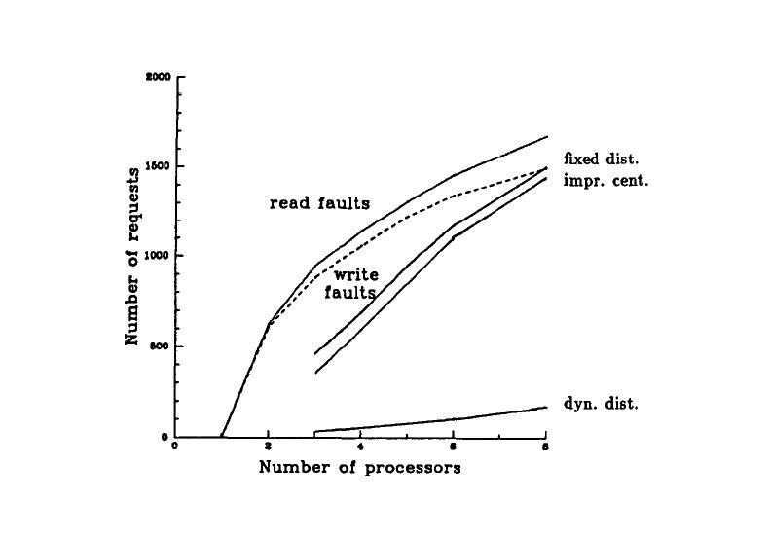
Experiments
Due to the limitation on the number of processors all 3 memory coherence algorithms have similar page faults
Many parallel programs exhibit good speedups using a shared virtual memory
Dynamic DMA better is that the probOwner fields give correct hints (despite to have less forwarding requests)
Notes:
-Four Parallel Programs
-Speedups
-Memory Coherence Algorithm
Number of forwarding request was used as a criterion for comparing all 3 algorithms.
Figure shows that the overhead of the Dynamic DMA is much less than of the other 2 algorithms.
In this article because of limited resource, they had run experiments only on 8 processors, thus we can not be sure about n up 8 processors how shared memory will scale,

Slide 42
Conclusion
Memory Coherence Problem
Distributed Manager
Centralized Manager
-easy to implement
- one manager, traffic bottleneck
Fixed distributed
-reduce the traffic bottleneck
-still need around two message to locate an owner
Dynamic Distributed
-performs better than other methods
- useful for a large-scale multiprocessor system

Slide 43
Q/A

Slide 44
Thank you

